Slide 1
Rehab for the Hand and Upper Extremity
introduction to the basics of Hand and Upper Extremity rehab

Slide 2
***Disclaimer***
This presentation is made to be a quick introduction to common assessments and also common treatment ideas for typical injuries of the hand and upper extremity.
This presentation will cover the hand, wrist, and elbow. It will not include the shoulder at this time.
It is up to the therapist and/or health care provider to use their best clinical judgment when treating the patient.
It is important to collaborate with Medical Doctors/Surgeons and to follow any specific protocols that may be set by the MD/Surgeon.

Slide 3
Examination of the Hand

Slide 4
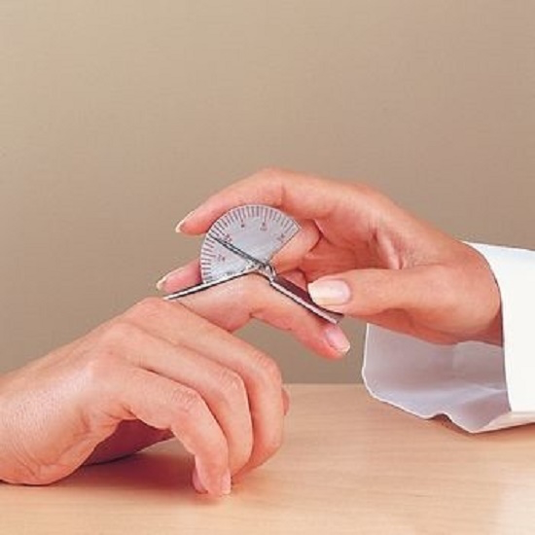
Examination of the Hand
Screen Hand/Finger ROM
  Observe Active range of motion (AROM) and perform Passive range of motion (PROM)
  If possible compare affected hand the the non-affected hand.
  If both hands are affected use standardized norms for range of motion.
  Usually if PROM is greater than AROM
  it may be due to muscle weakness.
  Use finger goniometer to measure
  fingers and thumb ROM.
  Source: Google Images

Slide 5
Examination of the Hand (cont.)
Hand/Finger ROM

Slide 6
Examination of the Hand (cont.)
Hand/Finger ROM
Source: https://www.eatonhand.com/cht/cht044.htm

Slide 7
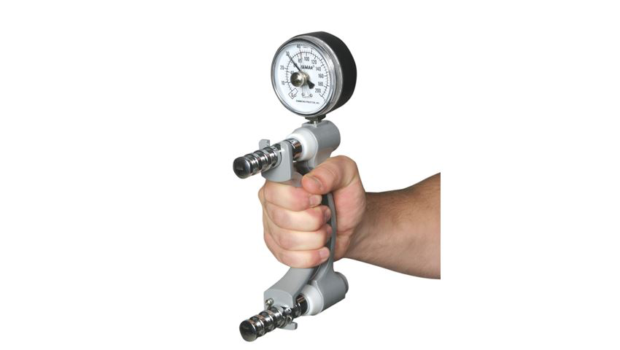
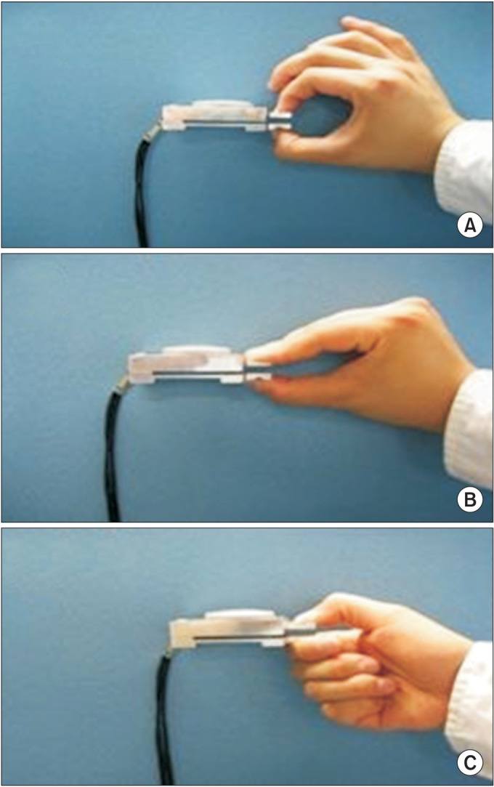
Examination of the Hand (cont.)
Measuring Strength of the Hand
  Grip Strength
    Use Dynamometer
  Pinch Strength
    Use small Dynamometer
    Check 3pt pinch (index finger, middle finger, and thumb) and Lateral pinch (thumb and lateral side of index finger)
Source:https://www.alimed.com/jamar-dynamometers.html?
Tip-to-Tip Pinch
3pt Pinch
Lateral Pinch
Source:http://europepmc.org/article/med/25379494

Slide 8
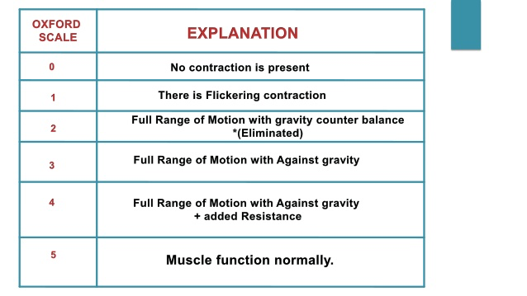
Examination of the Hand (cont.)
Measuring Strength of the Hand
    If you do not have access to these equipment, you can perform Manual Muscle Testing (MMT)
Source: https://www.slideshare.net/Ajithlolita/manual-muscle-test-mmt-129339656

Slide 9
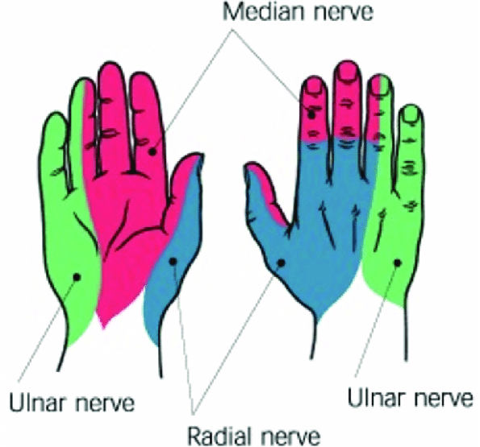
Examination of the Hand (cont.)
Sensory Testing on the Hand
  Innervated by 3 nerves: Median, Ulnar, and Radial

Slide 10
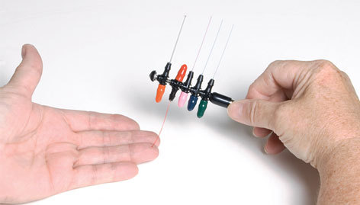
Examination of the Hand (cont.)
Sensory Testing on the Hand
  Performing light touch can be an easy way to check nerve innervation
    While the patient is looking away or eyes closed, gentle rub over the 3 main areas of nerve supply to the hand.
    If patient feels the light touch = less likely of nerve damage
    If patient does not feel light touch, you can increase pressure until sensation is felt.
  The most accurate way to test sensory innervation is to use Semmes Weinstein monofilament.
Source:https://www.prohealthcareproducts.com/west-hand-monofilaments-weinstein-enhanced-sensory-test/

Slide 11
Examination of the Hand (cont.)
Skin Integrity
  Wound Care
    Usually wound care is performed by nursing or Medical Doctors
    But it is important for therapists to monitor wounds post surgery and alert Medical staff of possible infections.
  Color wound classification
    Red
      Clean, healing, granulating
    Yellow
      Possible infection
      Contains devitalized slough, or fibrous exudate -> can promote bacterial growth/infect
    Black
      Necrotic/dead tissue -> medium for bacterial growth

Slide 12
Examination of the Wrist

Slide 13
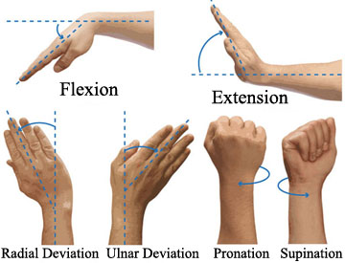
Examination of the Wrist
Screen Wrist ROM
  Same protocol as the hand
    (1) Screen AROM (2) Perform PROM (3) Record measurements using a goniometer of AROM/PROM

Slide 14
Examination of the Wrist (cont.)
Wrist ROM
  Flexion = 80-90 degrees
  Extension = 80-90 degrees
  Ulnar Deviation = 30 degrees
  Radial Deviation = 20 degrees
  Pronation = 80-90 degrees *Elbow at 90 degrees
  Supination = 80-90 degrees *Elbow at 90 degrees

Slide 15
Examination of the Wrist (cont.)
Measuring Strength of the Wrist
  Use MMT
Source: https://www.slideshare.net/Ajithlolita/manual-muscle-test-mmt-129339656

Slide 16
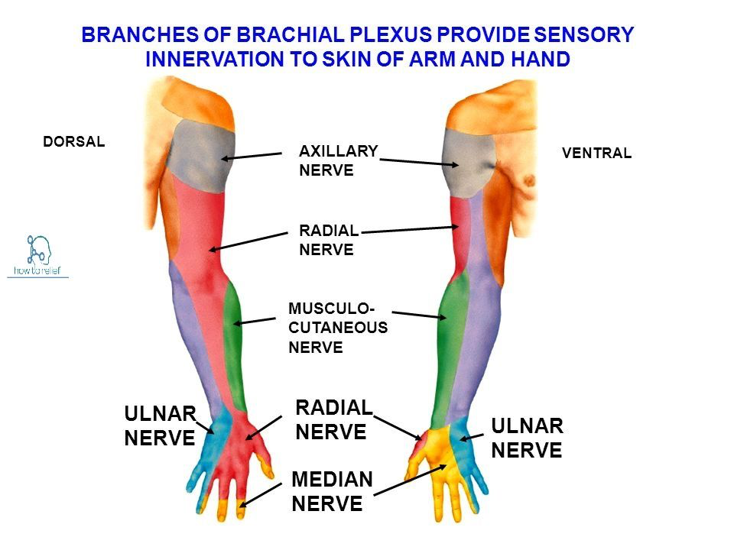
Examination of the Wrist (cont.)
Sensory Testing on the Wrist/Forearm
Source: Google Images

Slide 17
Examination of the Elbow

Slide 18
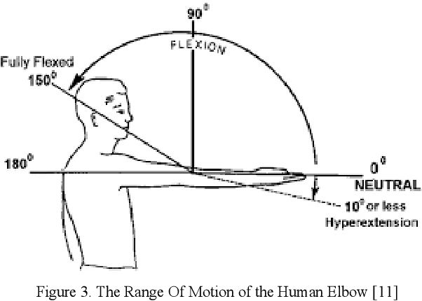
Examination of the Elbow
Screen Wrist ROM
  Same protocol as the hand
    (1) Screen AROM (2) Perform PROM (3) Record measurements using a goniometer of AROM/PROM
Source: Google Images

Slide 19
Treatments Ideas

Slide 20
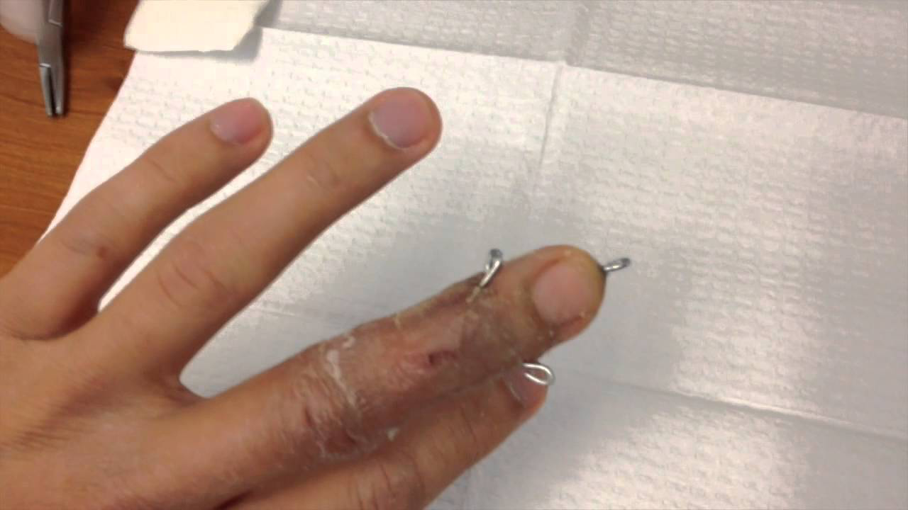
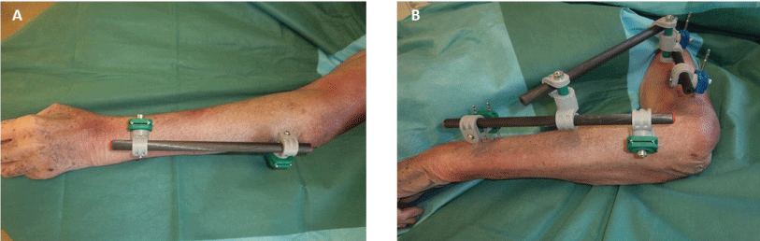
Fractures
Bones maybe placed together by pins or Open Reduction and Internal Fixation (ORIFs)
Before fractured body part can be rehabbed, the bones much first heal.
It is very IMPORTANT that you follow the surgeons protocol at this time.
Pin Example
Source: Google Images
ORIF Example
Source: Google Images

Slide 21
Fractures (cont.)
As these body parts are healing, non-fractured body parts should be mobilized as soon as possible and in full ROM.
It is also important to monitor the surgical sites for any sign and symptoms of infection, such as discoloration (yellow/green/black), pain, swelling, bad odor.
  Notify doctor or nursing as soon as possible, if positive.

Slide 22
Fractures (cont.)
Once pins and ORIFs are removed
  Begin AROM/PROM exercises
  At first, treatment should focus on recovering full ROM before strengthening.
  If you begin strengthening, start with isometric exercises and then move on to concentric/eccentric strengthening.
  Scar tissue management at surgical sites (scar tissue message)
  Heat to help relax muscles and joints. Always wrap heating pad before applying
  Manual therapy to help with AROM

Slide 23
AROM Exercise

Slide 24
AROM Exercise (cont.)

Slide 25
Amputation
For finger and limb amputations, again it is important to follow surgeon protocol.
It is important to know if they will be fitted with prosthesis, to start shaping the limb.
It is going to be important to start a desensitization program as soon as possible.
Again, you will follow the similar protocol as for fractures.
  Start with ROM then move on to strengthening
  Monitor skin for any infections

Slide 26
Amputation (cont.)
Desensitization program

Slide 27
Amputation (cont.)
Desensitization program

Slide 28
The End
Again, this was a presentation for a quick introduction to hand therapy. It is up to the treating therapist to use their best clinical judgment when treating.
Thank you for the opportunity to collaborate with therapists/healthcare professionals from Armenia.
I hope to continue the partnership in the future.
Presentation Created by: Edward Agazaryan, OTR/L
Occupational Therapist in Acute Care and Hand Therapy

