Slide 1

Anatomy of the Hand and Wrist
Jane Fedorczyk, PT, PhD, CHT
Director, Center for Hand and Upper Limb Health and Performance
Clinical Professor, Physical Therapy
Clinical Professor, Occupational Therapy
Jane.Fedorczyk@Jefferson.edu

Slide 2
Objectives
Review primary anatomical structures of the hand and wrist.
Apply knowledge of neuromusculoskeletal anatomy to normal wrist and hand movements and functional use of the hand/wrist.
Discuss the clinical significance of anatomical structures.
Acquaint student to relevant clinical information as it relates to anatomy

Slide 3
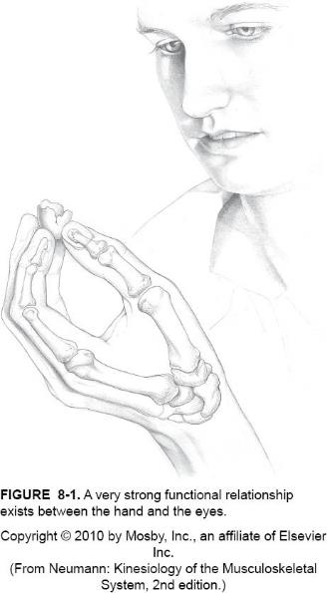
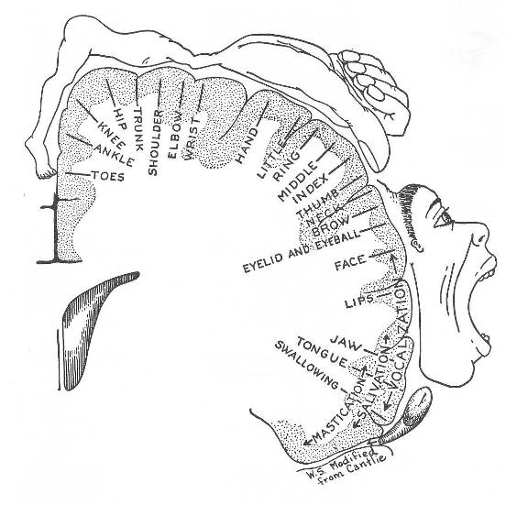
The Hand: Complex Motor Tasks,
Interaction/Perception with Environment

Slide 4
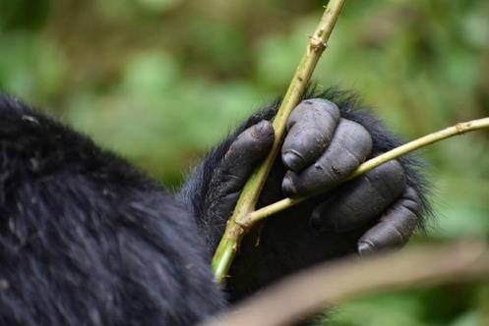
Components of Prehension
Strength
  Extrinsic and Intrinsic
ROM; pain free
Tendon Gliding
Lymphatic Function
Motor Control
  Motor plan
  Timing
  Recruitment
  Coordination
Stable Base especially wrist and thumb
Load Transfer
  Quality of bone and articular cartilage
Innervation
  Sensation
  Vascularity
  Skin Integrity
Hand of Mountain Gorilla, Rwanda

Slide 5
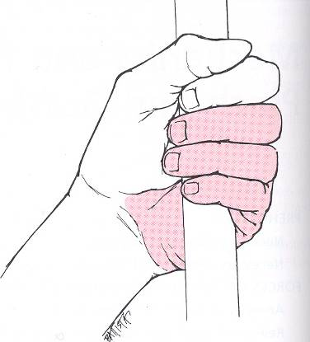
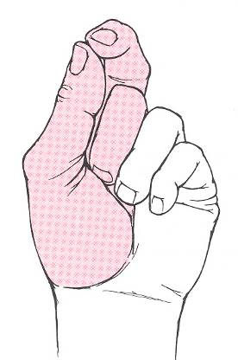
Prehension – two types
Grasp/Grip Pinch/Prehension
Notes:
Grasp and Pinch
Patterns used to hold and or manipulate objects in the hand
5

Slide 6

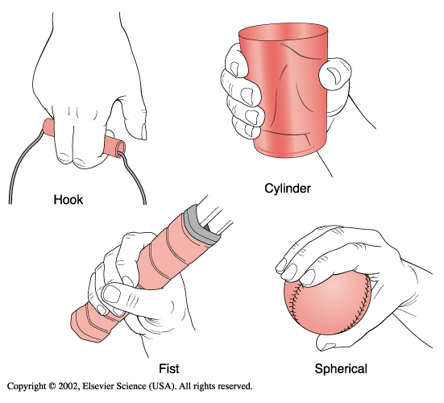
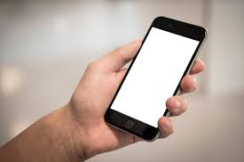
Grips/Grasp: uses all digits and palm

Slide 7
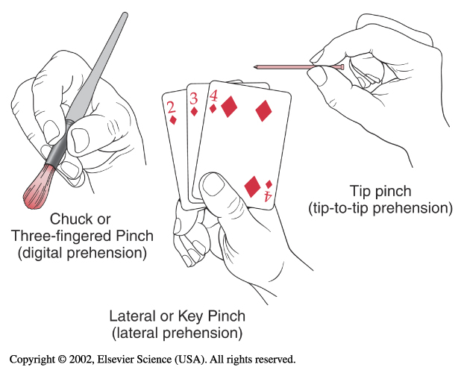
Pinch/Prehension
  Uses radial side of the hand – thumb, index, long fingers
  Opposition enables thumb to hold against stable post of index and long fingers
  Immobility of CMC for index and long provides stability

Slide 8
Hand Osteology
19 bones distal to the carpus
  5 Metacarpals (I-V)
  3 Phalanges (II-V)
  2 Phalanges (I)
RAY
IV
III
II
V
I

Slide 9
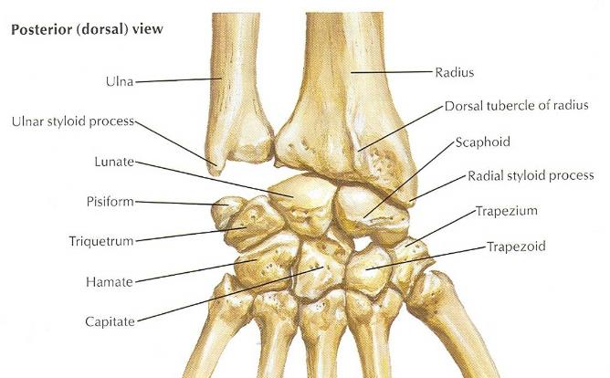
Wrist Complex: Osteology
Distal Radius and Ulna
  Radius extends more
  distally than ulna in AP
  and lateral views
8 Carpal Bones
  Proximal Row
  Distal Row

Slide 10
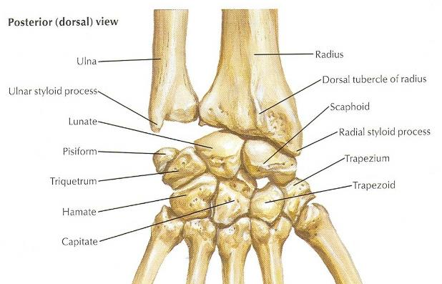
Proximal Row
Scaphoid
  Most commonly Fx
  Proximal pole has poor blood supply
  Forms floor of radial snuffbox
Lunate
  Most commonly dislocated
Triquetrum
Pisiform
  Sesamoid for FCU
No tendons insert onto to
scaphoid, lunate, & triquetrum

Slide 11
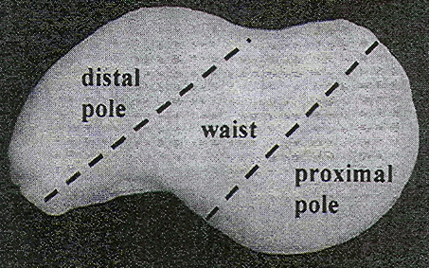
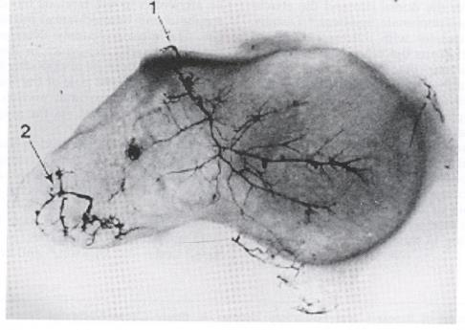
The Problematic Scaphoid –Blood Flow Impacts Healing Rates
Tubercle

Slide 12
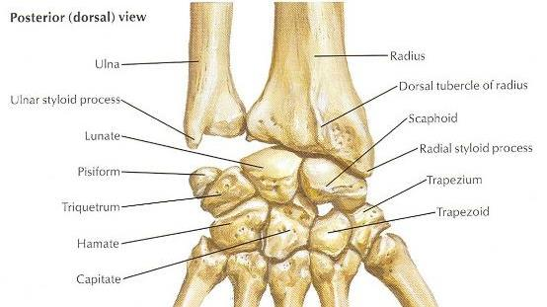
Distal Row
Trapezium
Trapezoid
Capitate
  Center of rotation
Hamate
  Ulnar nerve passes beneath hook of hamate

Slide 13
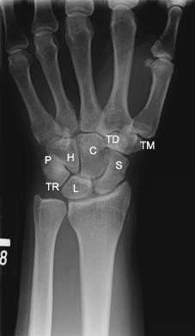
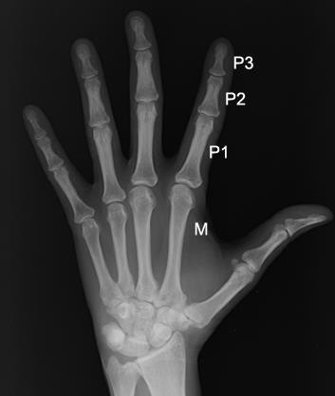
Bony Anatomy Hand/Wrist: Radiograph

Slide 14
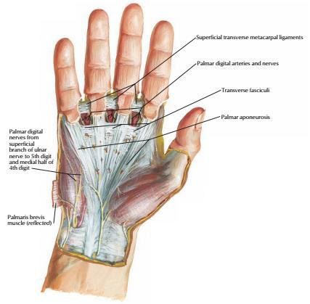
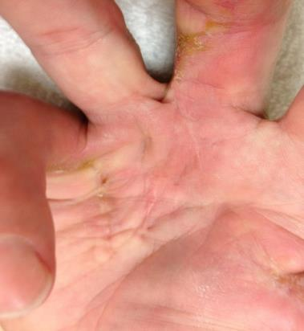
Palm of Hand
1st Layer
Palmar Aponeurosis
Dupuytren Disease

Slide 15
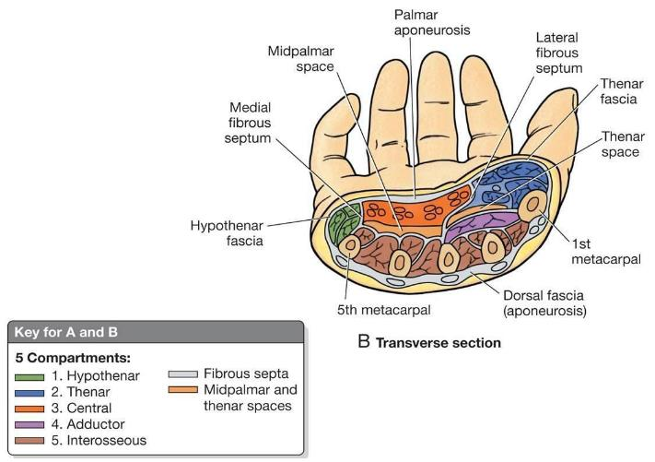
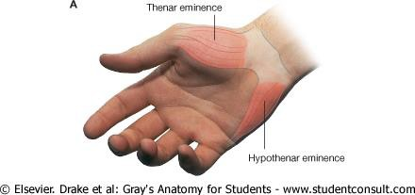
Compartments of the Hand

Slide 16
Muscles of the Hand: Extrinsic vs. Intrinsic
Extrinsic: originate in the forearm and insert in the hand
Intrinsic: originate in the hand and insert in the hand

Slide 17
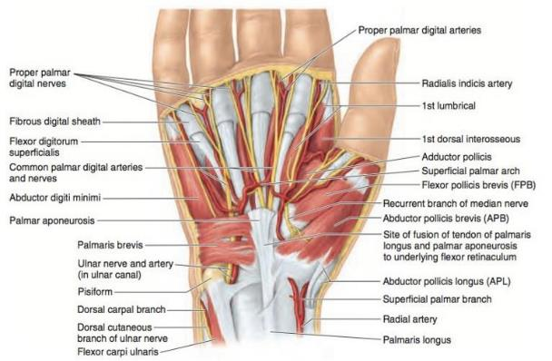
Palm of Hand
1st Muscular Layer: Thenar Muscles
Abductor Pollicis Brevis
  Origin: Scaphoid & Trapezium
  Insertion: Base of 1st Prox. Phalanx
  Action: Abducts thumb at CMC
  Innervation: Recurrent Branch of Median Nerve
Flexor Pollicis Brevis
Origin: Trapezium
Insertion: Base of 1st Prox. Phalanx
Action: Flexes CMC, PIP of thumb
•
Innervation: Recurrent Branch of Median Nerve

Slide 18
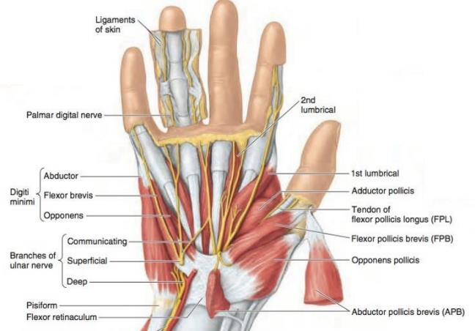
Palm of Hand
2nd Muscular Layer: Thenar Muscles
Opponens Pollicis
  Origin: Trapezium
  Insertion: Shaft of 1st metacarpal
  Action: Opposes thumb at CMC
  Innervation: Recurrent Branch of Median Nerve

Slide 19
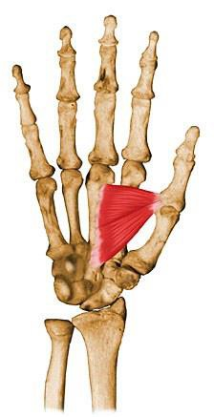
Palm of Hand
Adductor Pollicis
  Origin: Oblique head: base of the 2nd and 3rd metacarpals; Transverse head: shaft of the 3rd metacarpal
  Insertion: Base of Proximal phalanx
  Action: Adducts thumb
  Innervation: Ulnar nerve

Slide 20
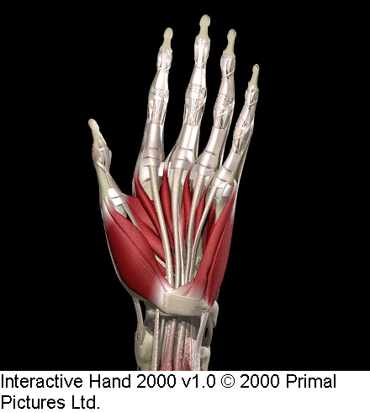
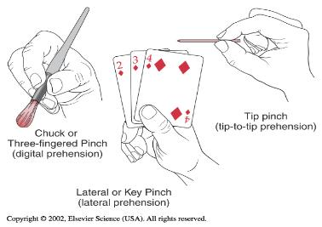
Mechanics for Pinch
Thenar Muscles (median nerve)
  Abductor Pollicis Brevis
  Flexor Pollicis Brevis
  Opponens Pollicis
Involved in placement and stabilization for prehension
Adductor Pollicis (ulnar nerve)
responsible for power/strength
Adductor
Pollicis
FBP
ABP
Thenar
OP deep to FBP and ABP

Slide 21
Hand Intrinsics: Hypothenar
Hypothenar Eminence (Ulnar)
  Abductor Digiti Minimi
  Flexor Digiti Minimi
  Opponens Digiti Minimi
  Allow independent function of the small finger allowing opposition towards thumb.

Slide 22
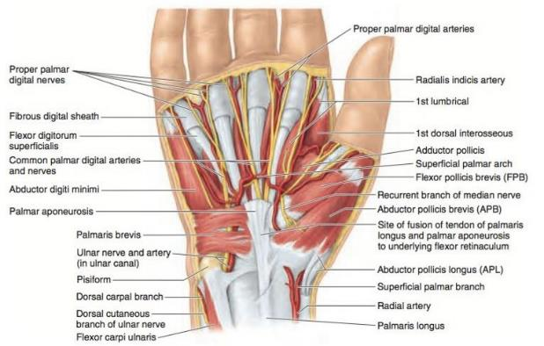
Palm of Hand
1st Muscular Layer: Hypothenar Muscles
Abductor Digiti Minimi
  Origin: Pisiform
  Insertion: Base of 5th Prox. Phalanx
  Action: Abducts 5th Digit
  Innervation: Ulnar Nerve
Don’t worry about palmaris brevis

Slide 23

Palm of Hand
2nd Muscular Layer: Hypothenar Muscles
Flexor Digiti Minimi Brevis
  Origin: Hamate
  Insertion: Base of 5th Prox. Phalanx
  Action: Flexes 5th CMC, MCP
  Innervation: Ulnar Nerve
Opponens Digiti Minimi
  Origin: Hamate
  Insertion: Shaft of 5th metacarpal
  Action: Opposes 5th digit
  Innervation: Ulnar Nerve

Slide 24
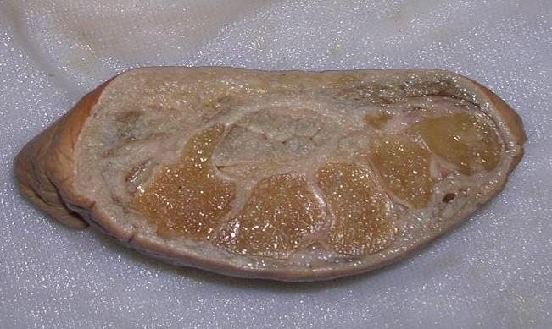
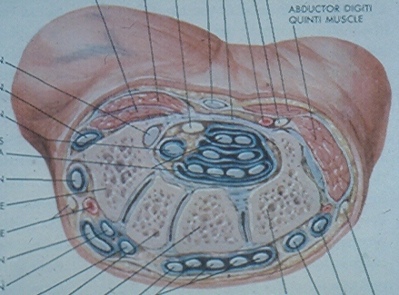
Carpal Tunnel
Median Nerve

Slide 25
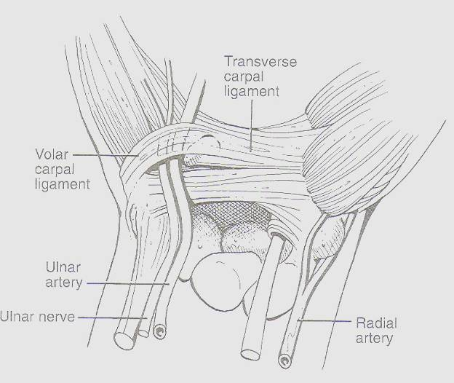
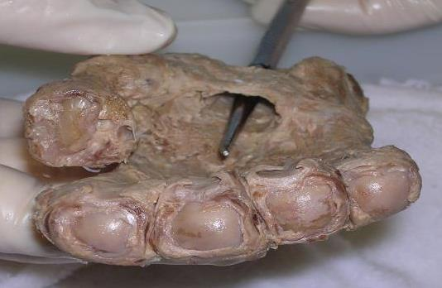
Transverse Carpal Ligament (TLC) serves as point of attachment of hypothenar and thenar muscles
Hypothenar
Eminence
Thenar
Eminence
When ligament is cut during carpal tunnel surgery, focal pain may develop at the attachment points called pillar pain

Slide 26
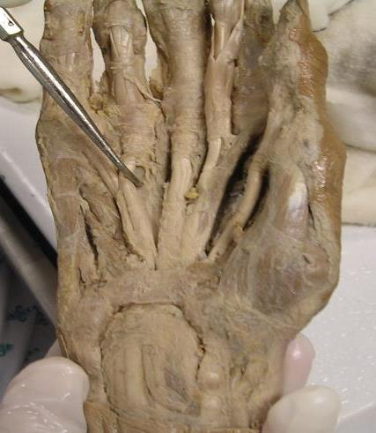
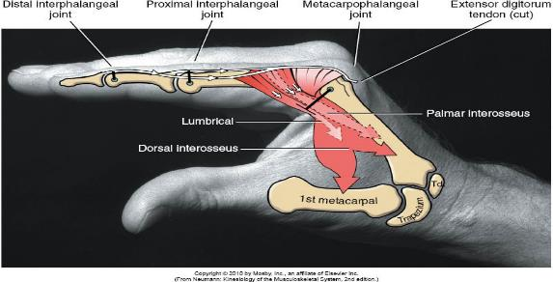
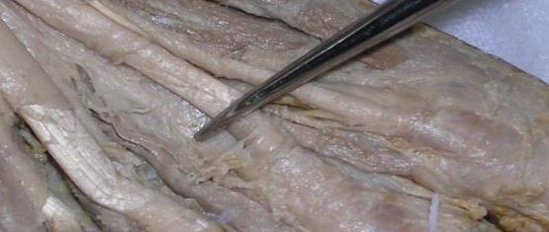
Hand Intrinsics: Lumbricals
Originate from FDP tendons and insert into lateral bands and dorsal hood
Contribute to MCP Flexion and IP Extension
Median – II,III
Ulnar – IV, V

Slide 27
Palm of Hand
3rd Muscular Layer
Lumbricals
  Origin: FDP tendons – radial side for 1 & 2; radial & ulnar side for 3 and 4
  Insertion: Radial side of proximal phalanges 2-5, on extensor hood
  Action: Flexes MCPs, extends PIPs and DIPs 2-5
  Innervation: Median nerve (1-2) Ulnar nerve (3-4)

Slide 28
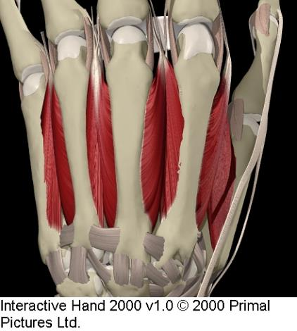
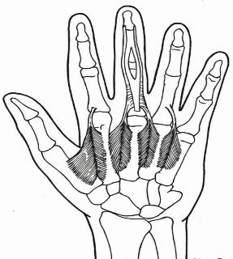
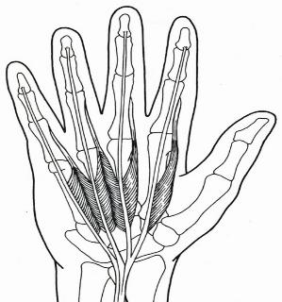
Hand Intrinsics: Interossei
(Dorsal and Palmar)
  With MCPs extended primarily abd/add
  With MCPs flexed primarily MCP flexors
  All ulnar innervated
  Contribute power to grip and pinch

Slide 29
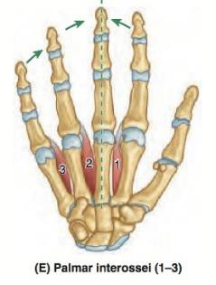
Palm of Hand
Palmar Interossei – 3 muscles
  Origin: Shafts of metacarpals 2, 4, & 5
  Insertion: Base of the proximal phalanx and extensor expansion of the ulnar side of digit 2, and radial side of digits 4 & 5
  Action: ADDucts fingers; Flexes MCPs, extends PIPs
and DIPs 2,4,5
  Innervation: Ulnar Nerve

Slide 30
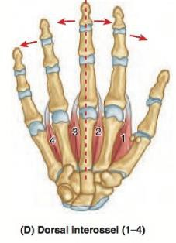
Palm of Hand
Dorsal Interossei – 4 muscles
  Origin: Adjacent metacarpal shafts of 1-5
  Insertion: Base of the proximal phalanx and extensor expansion on radial side of the 2nd digit, radial & ulnar sides of the 3rd digit, and ulnar side of the 4th digit
  Action: ABDucts fingers; Flexes MCPs, extends PIPs and DIPs 2 - 4
  Innervation: Ulnar nerve

Slide 31
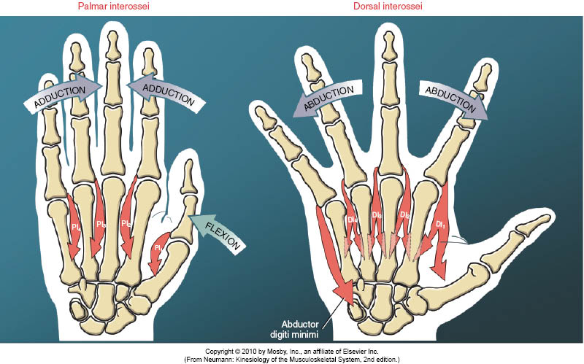

Slide 32
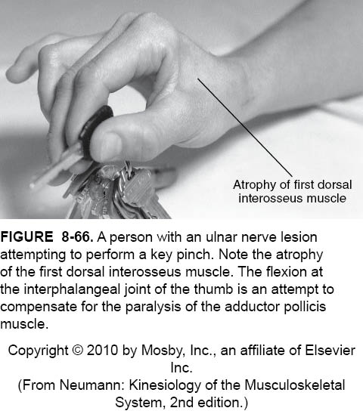
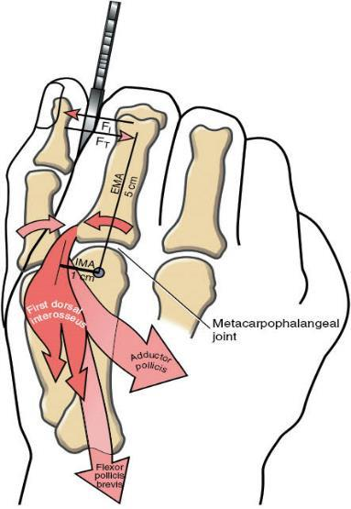
Forces in Key Pinch: Thumb Flx/Opp Opposed by 1st DI

Slide 33
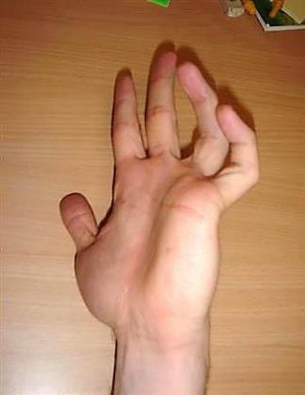
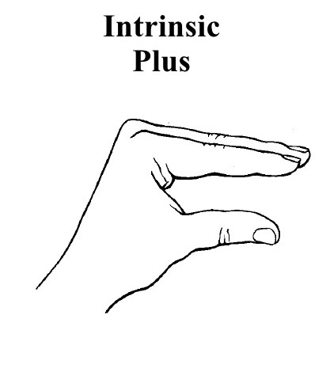
Intrinsic Muscles
The 3 “intrinsic” hand muscle groups (lumbricals and interossei) allow you to do this:
  Flex your MCPs
  Extends your IPs
  This is also called the “intrinsic plus” position
  If your patient is able to actively assume this hand position then their ulnar nerve is intact

Slide 34
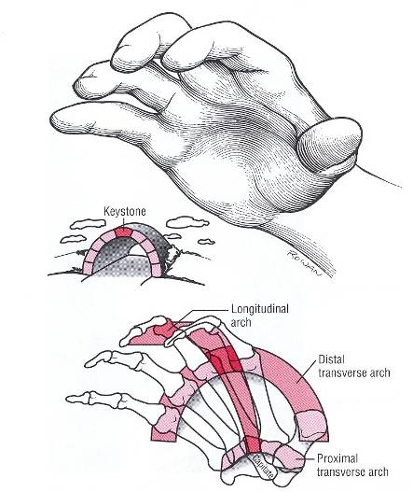
Role of Hand Intrinsic Muscles
Support Arches of the Hand: transverse, longitudinal, oblique
Contribute to production of grip & pinch strength
  about 50% grip (Kozin, 1989)
  about 80% pinch (Kozin, 1989)
Interossei are bipennate muscles with large cross-sectional area; capable of large force production

Slide 35
Extrinsic Musculature of the Hand
Extrinsics of the Digits
  Flexor Digitorum Superficialis (FDS)
  Flexor Digitorum Profundus (FDP)
  Extensor Indicis (EI)
  Extensor Digiti Minimi (EDM)
  Extensor Digitorum (ED)
Extrinsics of the Thumb
  Extensor Policis Longus (EPL)
  Extensor Pollicis Brevis (EPB)
  Abductor Pollicis Longus (APL)
  Flexor Pollicis Longus (FPL)

Slide 36
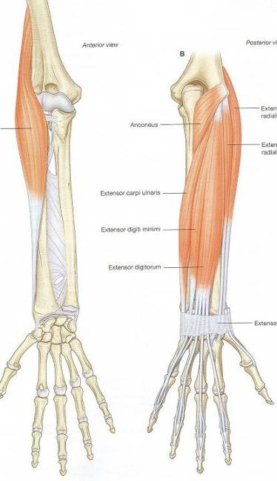
Extensors: Superficial Layer
Brachioradialis
ECRL
ECRB
ECRL/ECRB tendons
2nd compartment

Slide 37
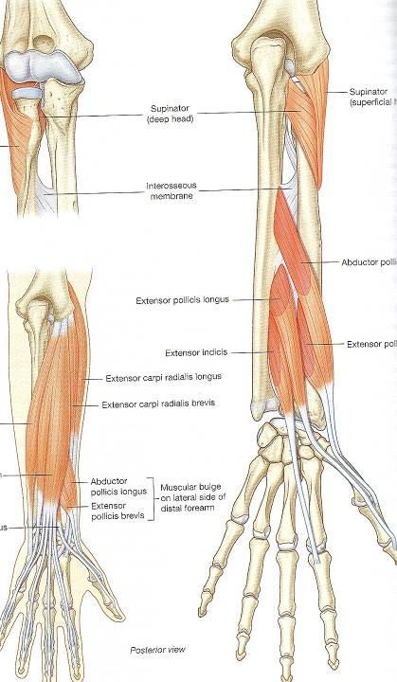
Extensors
Deep Layer
Abductor Pollicis
Longus
Extensor Pollicis
Brevis
Lister’s Tubercle

Slide 38
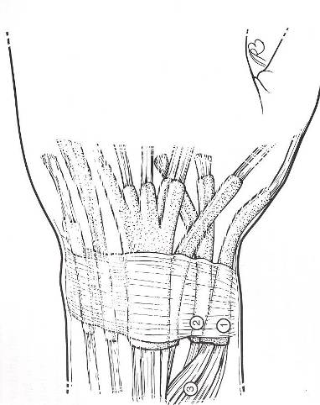
Extrinsic Extensors: 6 Compartments
I APL and EPB
II ECRL and ECRB
III EPL
IV EDC and EIP
V EDM
VI ECU
Separation occurs at retinaculum.

Slide 39
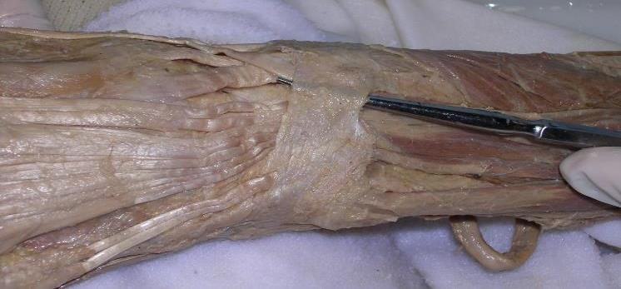
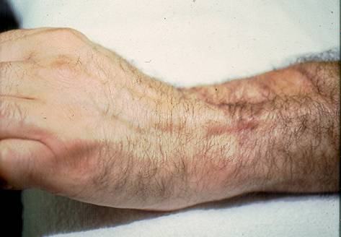
Flexors vs.
Extensors
Extensor do not have
a pulley system
“Bow stringing” at extensor retinaculum
All extensor tendons are extrasynovial except for zone 7

Slide 40

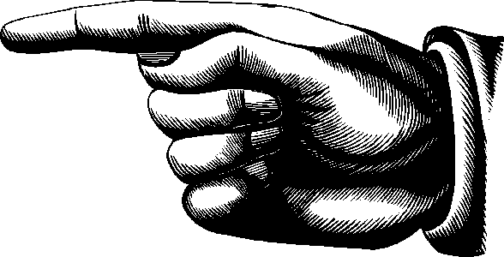
Extrinsic Extensors
EIP and EDM add independent function not strength

Slide 41
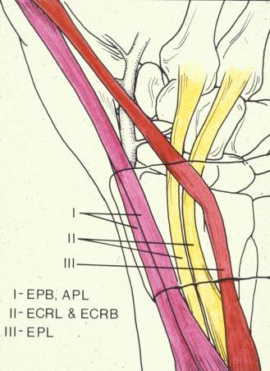

Extensor Pollicis Longus
Lister’s
Tubercle
Notes:
EPL tendinopathy not common – pain, tenderness, swelling at Lister’s Tubercle

Slide 42

Digital Flexors:
FDP, FDS, FPL
Flexor Digitorum Profundus
☺

Slide 43
Carpal Tunnel

Slide 44


Extrinsic Flexors:
FDS and FDP
Synovial linings decrease friction in tight places (CT and FDS bifurcation)
Function is dependent on intact gliding structures; sheaths and pulley system can enhance or impede gliding

Slide 45



Flexor Tendon Pulley System
Maintains tendons and sheath close to bone to prevent bow stringing and enhance mechanical advantage

Slide 46


Flexor Tendon Pulley System
Originally thought that A2 and A4 considered most crucial to prevent bowstringing; recent flexor tendon research suggests this may be fake news
Loss will result in decreased flexion ROM and grip strength

Slide 47



Vincula
Camper’s Chiasm

Slide 48
Flexors vs.
Extensors
Extensor do not have
a pulley system
“Bow stringing” at extensor retinaculum
All extensor tendons are extrasynovial except for zone 7

Slide 49


Juncturae Tendinae
Link EDC to prevent independent function
Maintain dorsal placement of extensors tendons over MPs during flexion

Slide 50



Bet You Can’t

Slide 51


Extensor Mechanism
EDC flattens into extensor hood just distal to MCP joint
Central tendon inserts onto base
of middle phalanx
Lateral bands arise at PIP joint and reunite into terminal tendon
PIP
MCP
DIP
PIP
MCP
DIP

Slide 52


Oblique Retinacular
Ligament (ORL)
ORL arises from the A2 pulley near proximal phalanx
ORL lies volar to PIP joint and dorsal to DIP joint

Slide 53

Extensor Mechanism
Oblique Retinacular Ligaments (ORL)
  Synchronous IP flexion or extension
Notes:
53

Slide 54



Slide 55


Vasculature
Deep Palmar Arch – continuation of Radial Artery
meets deep branch of Ulnar Artery
Superficial Palmar Arch – continuation of Ulnar Artery

Slide 56

Cutaneous Nerve Supply of the Upper Limb

Slide 57


Sensory Distribution in the Hand
Dorsal
Volar

Slide 58
Median Nerve Innervation
FDS
Lumbricals (II, III)
AbPB
OP
FPB (superficial head)
Pronator Teres (PT)
FCR
Anterior Interosseous
FDP II (III)
FPL
Pronator Quadratus

Slide 59
Ulnar Nerve Innervation
DI and PI
Lumbricals IV, V
AdP
FPB (deep head)
Hypothenar:
  AbDM
  FDM
  ODM
FCU
FDP IV, V (III)

Slide 60
Radial Nerve Innervation
Posterior Interosseous
EDC
EPL
EPB
APL
EIP
EDM
ECU
Supinator
ECRL
ECRB

Slide 61


