Slide 1
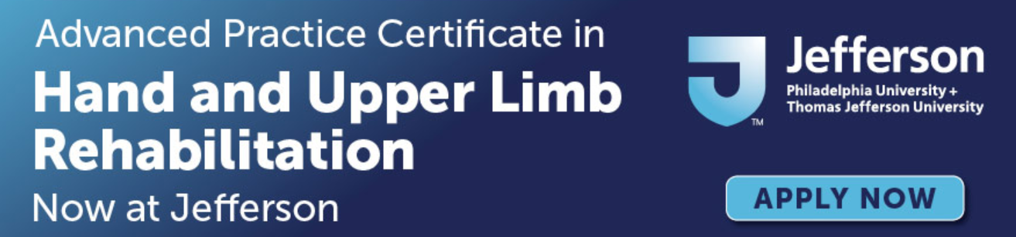
Anatomy of the Elbow, Wrist, and Hand Joints
Jane Fedorczyk , PT, PhD, CHT
Certified Hand Therapist
Jane.Fedorczyk@Jefferson.edu
Center for Hand & Upper Limb Health and Performance

Slide 2
Objectives
Describe anatomy of the elbow complex including the course of the peripheral nerves.
Describe anatomy of the wrist complex.
Describe the anatomy of the small joints of the hand.

Slide 3
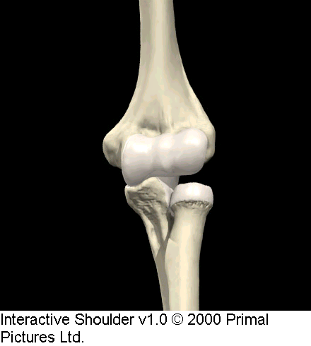
Elbow Complex: 3 Articulations
Ulnohumeral
Radiohumeral
Superior or Proximal Radioulnar Joint
(PRUJ)
H
T
C
O
RH
U
R

Slide 4
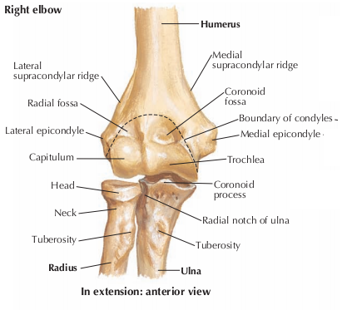
Elbow Joint
  Diarthrosis, synovial, hinge
  Movements = Flexion/Extension
  Humeroulnar Joint
    Trochlear notch of ulna and trochlea of
    humerus
  Humeroradial Joint
    Radial head and capitulum of
    humerus
Humeroradial Joint
Humeroulnar Joint

Slide 5
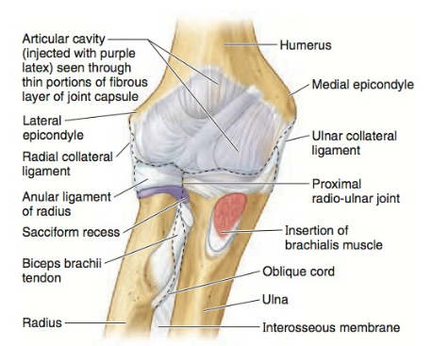
Proximal Radioulnar Joint
    Proximal Radioulnar Joint
    Synovial, pivot joint , diarthrosis
    Pronation and supination
    Radial head and radial notch of the ulna
      Radial notch also known as lesser sigmoid notch
    Annular ligament makes it all possible

Slide 6
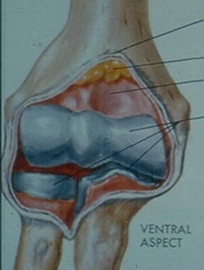
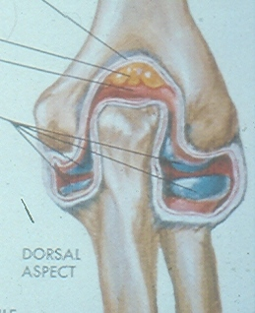
Elbow Complex: Osteology
“Lock and Key” Configuration Primary to Stability

Slide 7
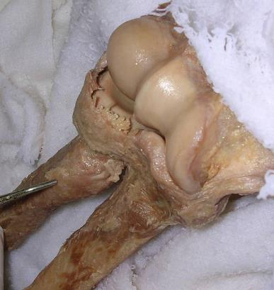
Articular Configuration
Adds to Stability
C
T
C
T
RH
CP
CP
RH

Slide 8
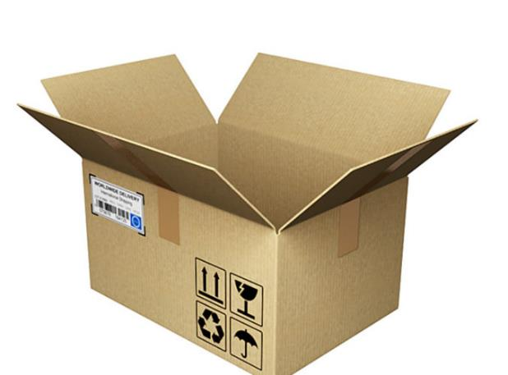
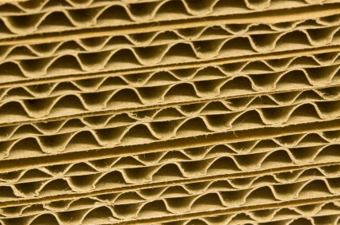
Articular Configuration
Adds to Stability

Slide 9
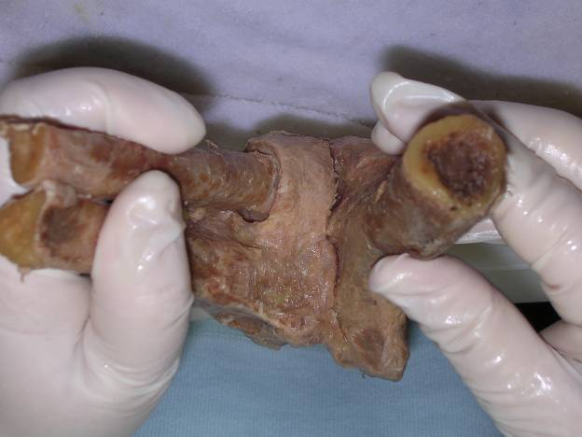
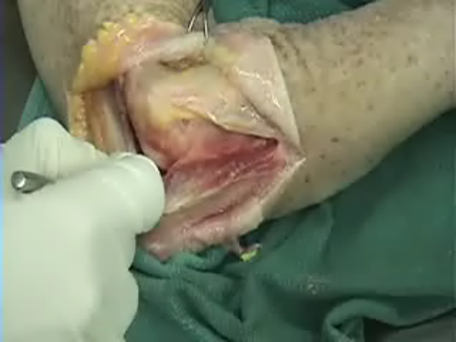
Elbow Most Stable in Flexion

Slide 10
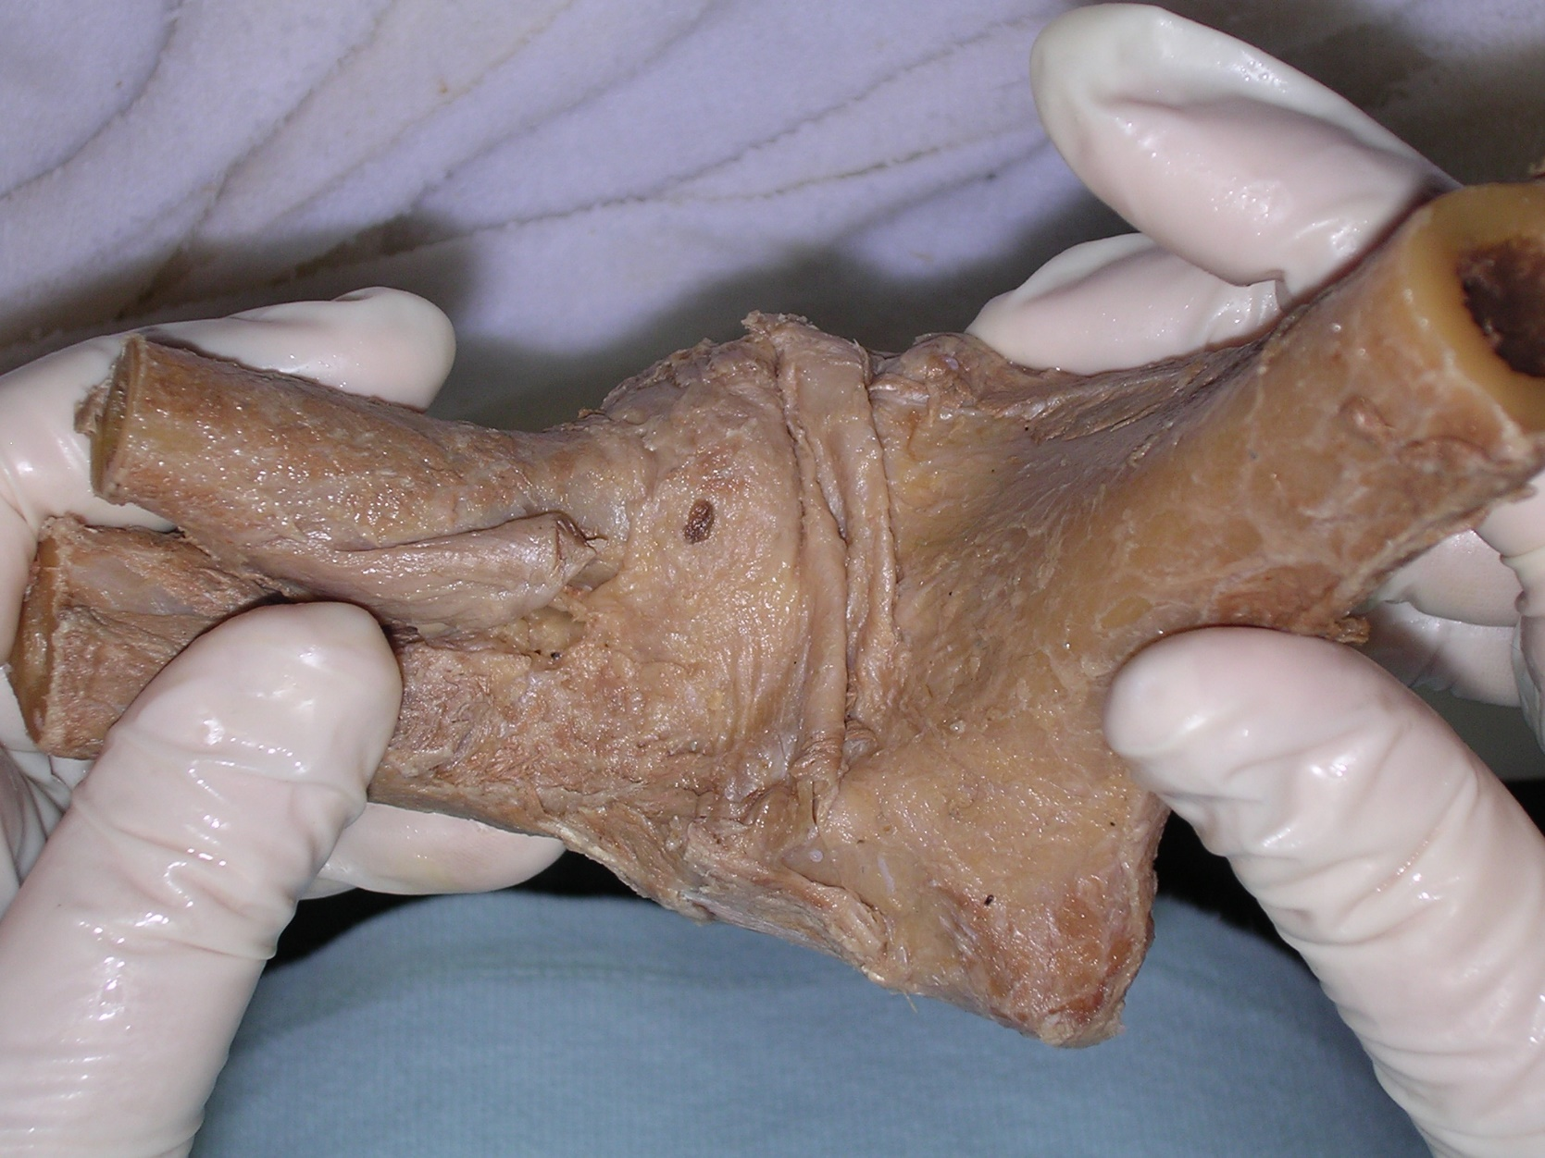
One Capsule Surrounds All Joints

Slide 11
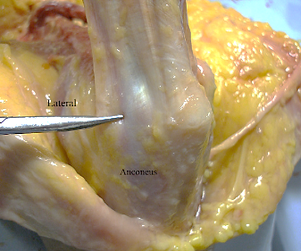
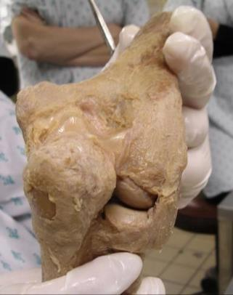
One capsule
surrounds all joints!
Tension from
anconeus
pulls posterior
capsule away
from joint lines

Slide 12
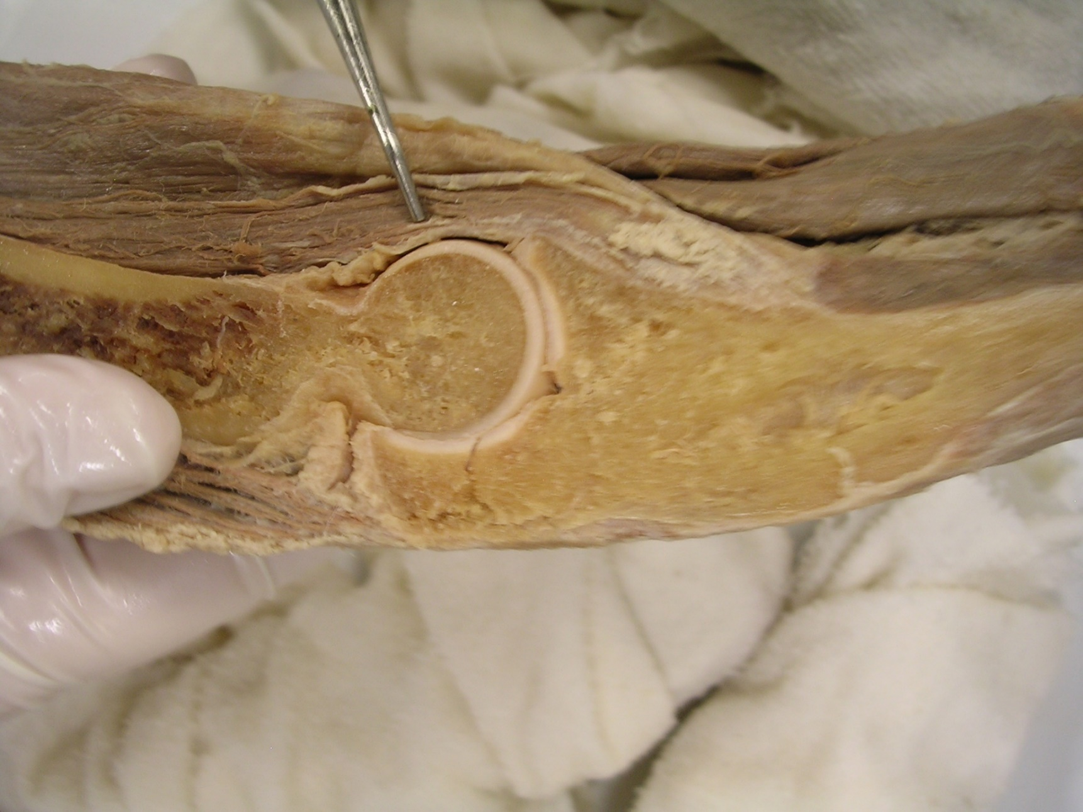
Brachialis Adherent to Anterior Capsule
H
T
U

Slide 13
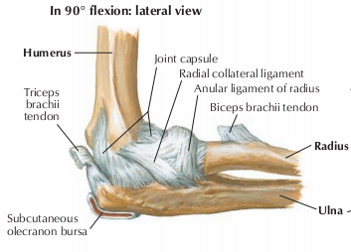
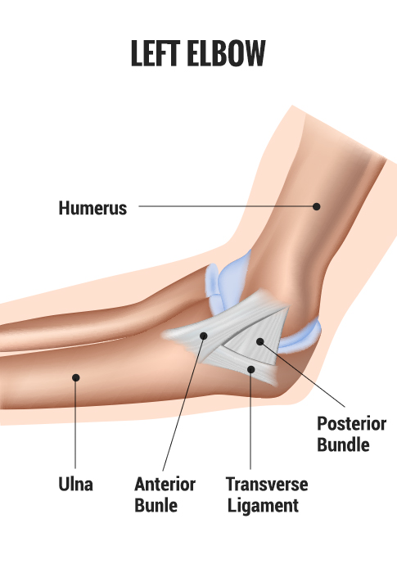
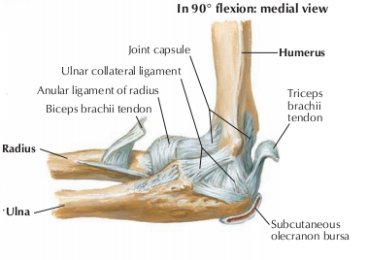
Ligaments of the Elbow and Forearm
  Ligaments of the Elbow
    Radial/lateral collateral ligament
    Lateral epicondyle to annular ligament
    Lateral, fan like
    Prevents against a varus force
    Ulnar/medial collateral ligament
    Medial epicondyle to coronoid process and olecranon
    Medial, triangular (3 bands)
    medial epicondyle to coronoid process (anterior); ulna (posterior)
    Prevent against a valgus force
http://doctorhackett.com/tommy-john-surgery/

Slide 14
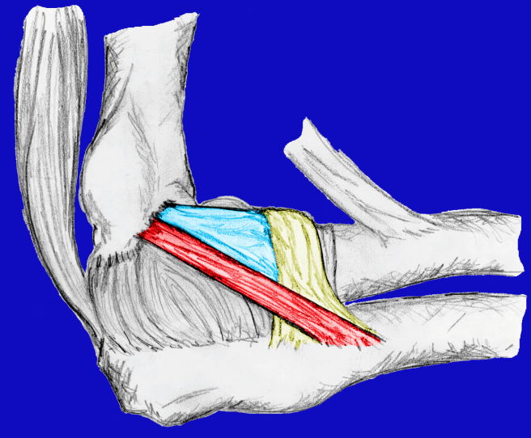
Lateral Collateral Ligament Complex
Lateral Radial Collateral
Triceps
H
Biceps Tendon
R
U
Lateral Ulnar
Collateral
Annular
Ligament

Slide 15
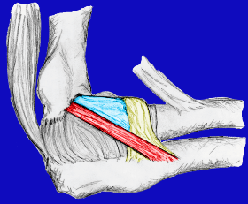
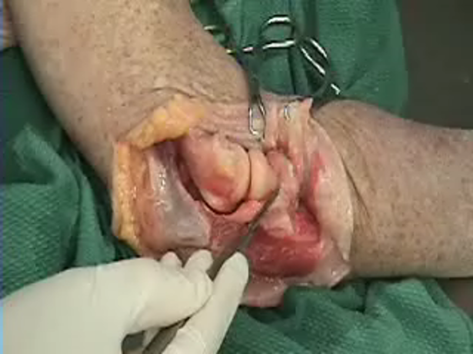
Elbow: Lateral Ligaments

Slide 16
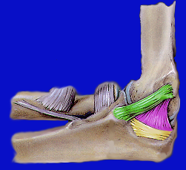
Medial or Ulnar Collateral Ligament Complex
Anterior Band
Posterior Band
Transverse Band

Slide 17
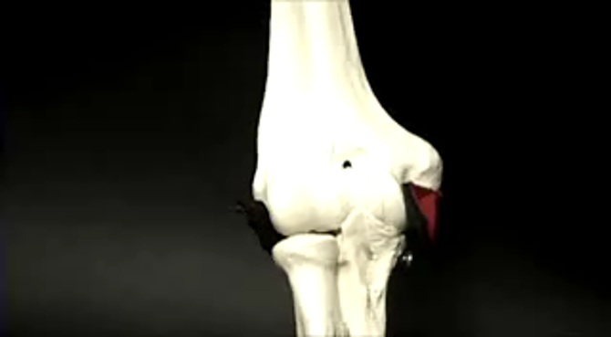
Elbow Complex: Medial Ligaments

Slide 18
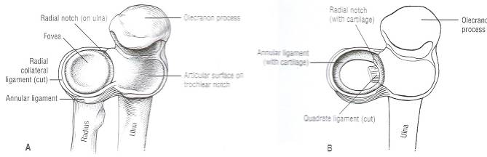
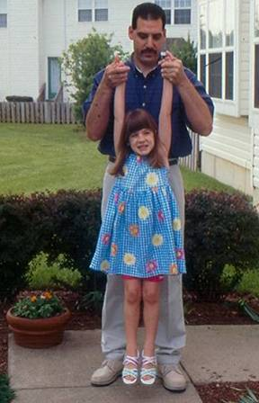
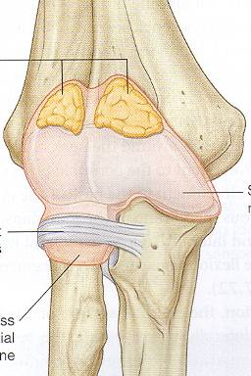
Annular Ligament: Nursemaids Elbow

Slide 19
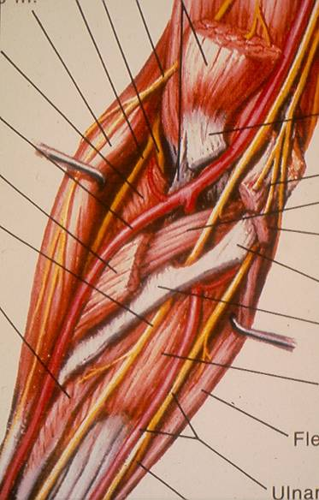
Nerves at the Elbow
Radial nerve
PIN
Median nerve
DSRN
Ulnar nerve
DSRN = dorsal sensory
radial nerve
PIN = posterior
interosseous
nerve

Slide 20
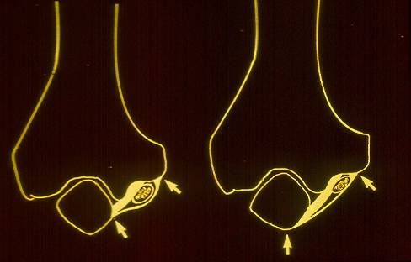
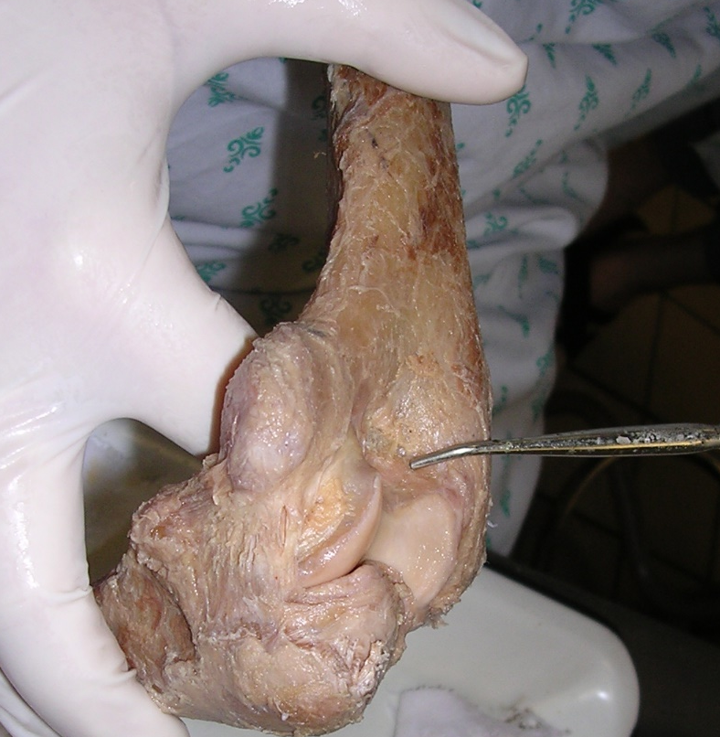
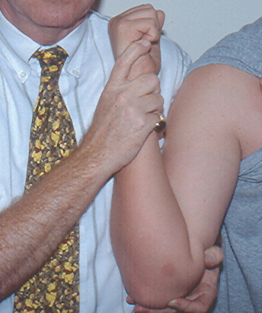
Elbow Flexion

Slide 21
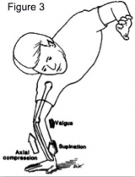
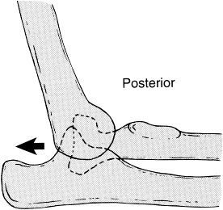
Coronoid and Radial Head Act as a Buttress to Posterior Deforming Forces Imposed by Biceps, Brachialis, and Triceps
CP
of
ULNA
RH
fovea

Slide 22
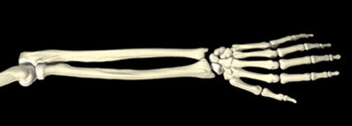
Forearm Rotation: Supination/Pronation
PRUJ
DRUJ

Slide 23
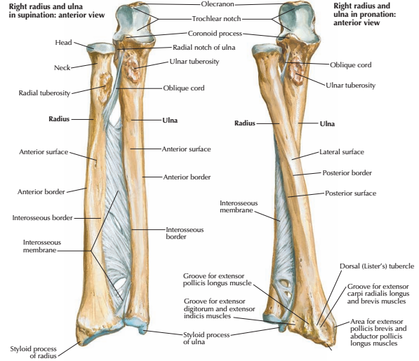
Ligaments of the Elbow and Forearm
  Ligaments of the Forearm
    Interosseus Membrane
    Radius to Ulna
    Stabilizes forearm
    Muscle attachments site
    Pathway for neurovascular structures

Slide 24
Anatomy of the Wrist Joints
Jane Fedorczyk , PT, PhD, CHT
Certified Hand Therapist
Jane.Fedorczyk@Jefferson.edu
Center for Hand & Upper Limb Health and Performance

Slide 25
Wrist Complex
Unlike shoulder, elbow, and forearm, the wrist does not play a primary role in hand placement
Provides a stable base to generate force for grip and prehension
Provides mobility to accommodate fine adjustments in hand position to achieve optimal length-tension relationships
Wrist must tolerate load transmission during prehension and closed chain activities
Choose Stability Over Mobility

Slide 26
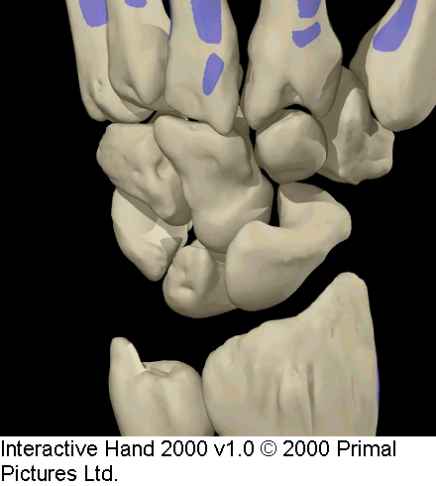
Major Load Bearing Column
CMC II and III
Capitate
Most of Scaphoid
Lunate
Distal Radius
70-85% of Load (80%)
40-50% Radioscaphoid
30-35% Radiolunate
Td
Tm
H
C
Tr
S
L

Slide 27
Minor Load Bearing Column
Distal Ulna
TFCC
Triquetrum, Hamate
CMC IV, V
15-30% of Load (20%)
H
Tr

Slide 28
Loading the Wrist
Load Transmission Altered:
  Change in length of radius (shortens) or ulna (lengthens?)
  With Forearm Rotation (pronation)
Consequences of Altered Load:
  Ulnocarpal impingement
  Carpal instability
  Degenerative Changes to TFCC, carpal bones (avascular necrosis)

Slide 29
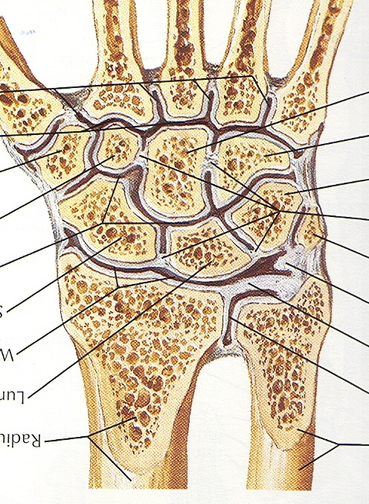
Articulations of the Wrist
Radiocarpal Joint
Midcarpal Joint
Distal or Inferior Radioulnar Joint
Note separate joint capsules for each
PCR interposed or intercalated between
DCR and distal radius

Slide 30
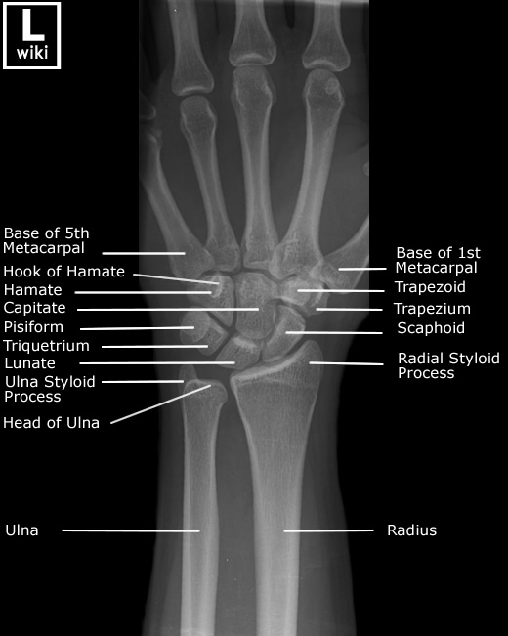
Joints of the Wrist Region
  Radiocarpal Joint = Wrist Joint
  Type of Joint
    Diarthrosis, condyloid, synovial
  Articulating Surfaces
    Distal radius
    Scaphoid, lunate, triquetrum
  Movements/Function
    Flexion, extension, radial and ulnar deviation
  Considerations
    Ulna is not part of this joint
    Stabilized by palmar/dorsal radiocarpal and collateral ligaments
Radiocarpal Joint

Slide 31
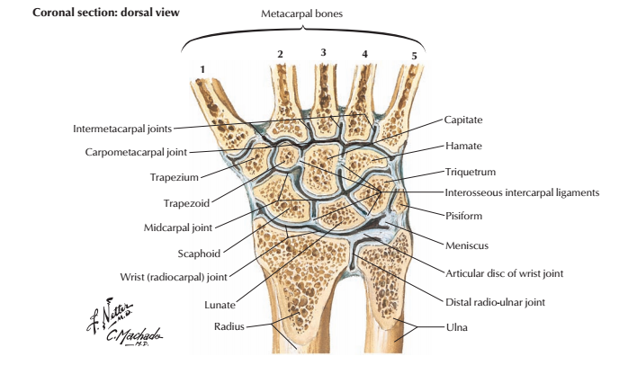
Joints of the Wrist Region
  Midcarpal Joint
    Plane, synovial
    Between proximal and distal rows of carpals
  Carpometacarpal Joints 2-5
    Plane, synovial
    Between distal carpals and base of metacarpals
  Intermetacarpal Joints
    Plane, synovial
    Between bases of the metacarpals

Slide 32
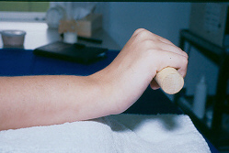
Wrist Motion
Forearm Rotation
  supination/pronation
  PRUJ, DRUJ, IOM
Flexion
Extension
Radial Deviation
Ulnar Deviation
Ruby, 1988
  Passive supination of carpus; can’t measure

Slide 33
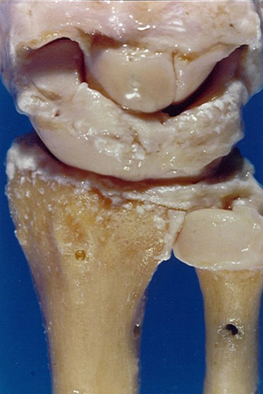
The overall motion in the wrist is the sum of the carpal bones moving on each other, influenced by their articulations, ligamentous attachments, and indirect actions of adjacent tendons.
C
S
T
L
LT

Slide 34
Location of Movement: RC vs.MC
Author | Flexion | Extension | Radial Deviation | Ulnar Deviation
Kapandji | RC>MC | MC>RC | RC=MC | RC=MC
Ruby | MC=RC | MC=RC | MC>RC | MC>RC
Saraffian | MC>RC | RC>MC
Wrist motion occurs at both MC and RC joints
About 50/50 split between MC and RC
Clinical significance if partial wrist fusion indicated; patient has potential to recover about 50% of motion

Slide 35
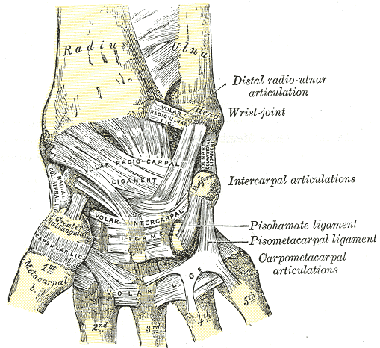
Ligaments of the Wrist
Separate Joint Capsules
Muscle Forces Move Wrist at MC Joint
Passive Forces Move Wrist at RC Joint
Certain Ligaments Significant for Carpal Bone Stability

Slide 36
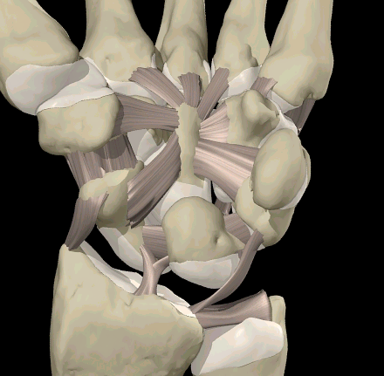
Intrinsic Ligaments
Attach to carpal bones in same or different row
  Short
  Long
  Intermediate
L

Slide 37
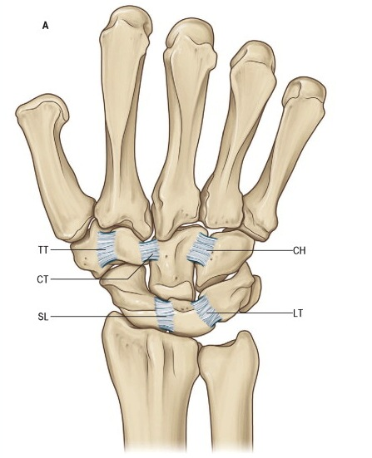
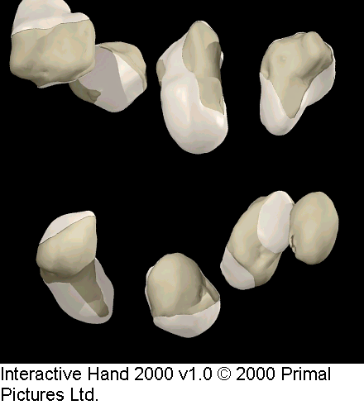
Intrinsic Ligaments
Carpus is spring loaded like a “jack in the box”
Intrinsic ligaments maintain this architecture
The 2 most important intrinsic ligaments are: ScaphoLunate (SL) LunoTriquetral (LT)

Slide 38
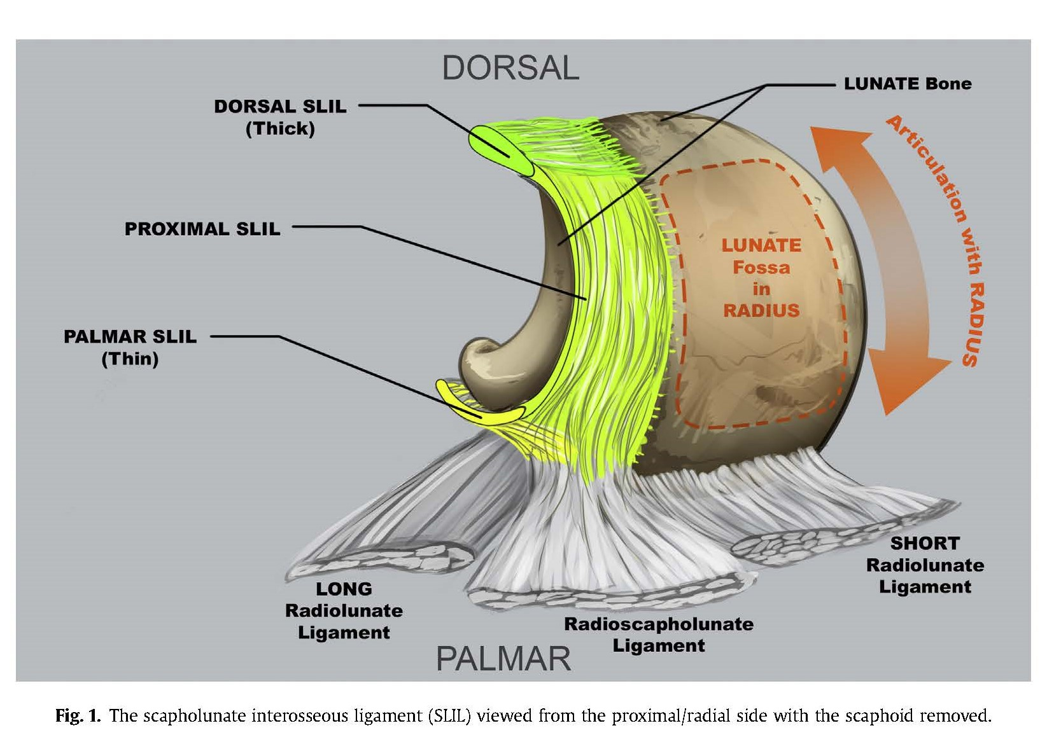
Scapholunate Interosseus Ligament (SLIL)
Dorsal: strongest; most critical to SL stability; primary restraint during flexion/extension
Volar: weaker than dorsal but controls rotational SL stability
Proximal: membranous; little consequence to SL stability

Slide 39
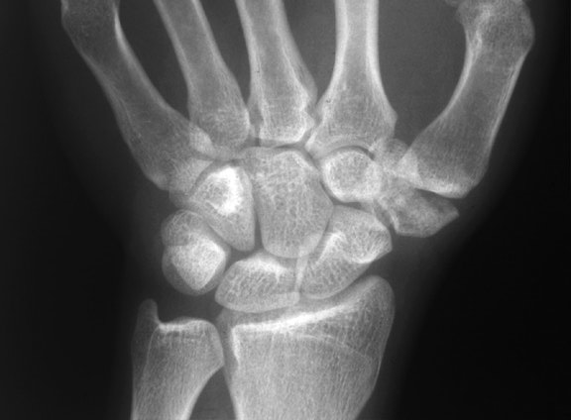
Normal Wrist X-ray
C
S
L

Slide 40
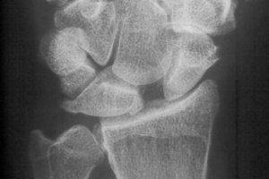
SLAC Wrist due to disruption of Scapholunate Ligament
SL Dissociation Most Common Carpal Instability
(DISI = dorsal intercalated segment instability)
C
S
L

Slide 41
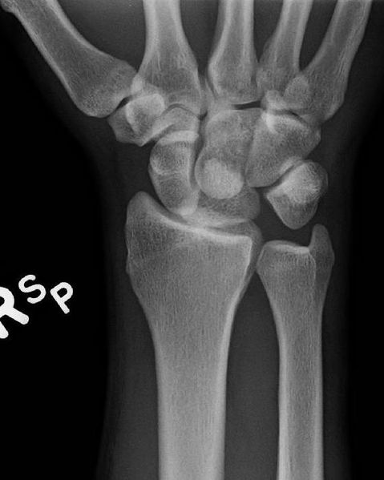
Disruption of Lunotriquetral Ligament
2nd most frequent carpal instability
Volar intercalated segment instability= VISI

Slide 42
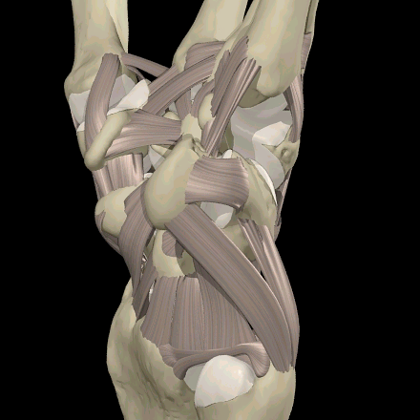
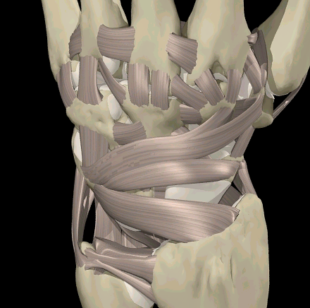
Extrinsic Ligaments
Volar
Volar
Dorsal

Slide 43

Volar Extrinsic Ligaments
Originate from Radius or Ulna and attach to carpal bones
All cross RC joint
Some cross MC joint
Provide stability during wrist motion
P
RSC

Slide 44

Ulnocarpal Ligaments
Ulnolunate (UL)
Ulnotriquetral (UT
Ulnocapitate (UC)
UC
Anchor the lunate and triquetrum to the ulna stabilizing the ulnar corner of the wrist
Notes:
Draw fig 11 2-97?

Slide 45

Dorsal Carpal Ligaments
Dorsal radiocarpal & dorsal intercarpal ligaments play an important role in carpal stability & carpal kinematics
Scaphoid stabilizers
Viegas, 1999

Slide 46

Distal Radioulnar Joint
    Distal Radioulnar Joint
    Synovial, pivot joint, diarthrosis
    Pronation and supination
    Ulnar head and ulnar notch of the radius
    Stabilized by interosseous membrane and Triangular fibrocartilage complex
Head of Ulna

Slide 47


DRUJ
Distal Radioulnar Joint
Distal radius articulates with ulnar head at the sigmoid or ulnar notch
Articulating surface of the ulnar head is the seat
75% of the circumference of the head is covered with articular cartilage

Slide 48

Triangular Fibrocartilage Complex
Components
  Intra-articular disc
  UCL
  R-U Ligaments
Function
  Supports DRUJ
  Adds to articular surface of radius
  Compensates for shorter ulna in load transmission
TFCC
DRUJ

Slide 49


TFCC
Originates from sigmoid notch and inserts into the ulnar fovea and the base of the styloid
Includes dorsal and volar radioulnar ligaments, ulnocarpal ligaments, ECU subsheath, and articular disc or meniscus homologue
(TFC proper)

Slide 50

TFCC
Originates from sigmoid notch and inserts into the ulnar fovea and the base of the styloid
Includes dorsal and volar radioulnar ligaments, ulnocarpal ligaments, ECU subsheath, and articular disc or meniscus homologue
(TFC proper)

Slide 51


Dorsal and Volar Radioulnar Ligaments
Dorsal: Attach to radius at dorsal sigmoid notch
Volar: Attach entirely to the fovea;
Attach to radius at volar
sigmoid notch; interdigitates
with DRU ligament;
acts as proximal
attachment of the UL
and UT ligaments
Notes:
51
May 1998 P 168

Slide 53
Anatomy of the Hand Joints
Jane Fedorczyk , PT, PhD, CHT
Certified Hand Therapist
Jane.Fedorczyk@Jefferson.edu
Center for Hand & Upper Limb Health and Performance

Slide 54

1st Carpometacarpal Joint
  Type of Joint
    Diarthrosis, saddle, synovial
  Articulating Surfaces
    Trapezium
    Base of 1st Metacarpal
  Movements/Function
    Flexion, extension, abduction, adduction, opposition
  Considerations
    Remember atypical planes for movement as we discussed
1st Carpometacarpal Joint

Slide 55



CMC Joint Anatomy- inherently unstable and at risk for degenerative changes
CMC joint has limited bony constraints
Dependent on soft tissue restraints for static stability
Provides exceptional mobility
Large contact stresses within the joint
Limited surface area to dissipate forces of 8 tendons

Slide 56


Anterior Oblique Ligament of the 1st CMC Vulnerable to Injury

Slide 57

Extrinsic and Intrinsic Tendon Forces
Cooney, et al. 1977
Joint compression forces averaged 12 kg at the CMC joint during simple pinch with 1 kg of applied force
Compression forces of as much as 120 kg may occur at the CMC joint during strong grasp

Slide 58



Shoulder Sign
CMC Arthritis

Slide 59
Joints of the Phalanges
  Metacarpophalangeal Joints
    Condyloid, synovial
    Between metacarpal heads and bases of the proximal phalanges
    Flexion, extension, abduction, adduction
  Interphalangeal Joints
    Hinge, synovial
    Between heads and bases of phalanges
    Flexion, extension
2nd DIP
2nd PIP
2nd MCP

Slide 60

MCP Joints
Condyloid Joints:
flexion/extension
abduction/adduction
Digits II-V
Motion increases radial to ulnar in digits
0/90-110 degrees
Hyperextension consistent across digits; varies among individuals
MC
P1

Slide 61

Ligaments of the MCP Joints
Loose Joint Capsule
Volar Plate
Collateral Ligaments
  Proper
  Accessory

Slide 62


MCP Joints: Thumb
MCP joint motion varies widely amongst individuals
Abduction, adduction, and long axis rotation function to provide additional range for opposition to enhance grasp and prehension.
Axial rotation allows for pad to pad prehension.
UCL
Tear
rotation

Slide 63

MCP Joint: Collateral Ligaments
Due to cam-shaped metacarpal head, the collateral ligaments are:
  Taut in Flexion
  Slack in Extension
Collateral ligament length maintained @ 45-70° flexion

Slide 64

IP Joints: Structure and Function
Amount of DIP
motion varies
Among
individuals;
60-80°common
PIP and DIP joint have
similar configuration
PIP most
important joint
for hand
function
Supporting structures:
joint capsule
collateral ligaments
volar plate

Slide 65

Anatomy of the PIP joint
Notes:
Figure 1. Anatomy of the PIP joint. Drawing (lateral view) shows the accessory collateral ligament (ACL), extensor central slip (ECS), flexor tendons (FT), middle phalanx (MP), proper collateral ligament (PCL), proximal phalanx (PP), and volar plate (VP).

Slide 66


Volar Plate
Enhances joint stability
With flexion, proximal portion buckles/folds like accordion
Stability of volar plate enhanced by attachment of accessory collateral ligaments and the checkrein ligaments (CRL)
Clavero J A et al. Radiographics 2002;22:237-256

Slide 67




Slide 68

Volar Plate Structure
Critical
Corner
Critical
Corner

Slide 69


Disruption of the
Critical Corner
leads to PIP dislocation
Dorsal – VP injury
Volar – Extensor Tendon Injury

Slide 70


Boutonniere Deformity is a clinical example of a disruption of the extensor mechanism

