Slide 1
Pressure Mapping
Nicole Shirley, PT, DPT, NCS
February 2021

Slide 2
Objectives
Identify the goals of pressure mapping
Know how to prepare for a pressure mapping session
Understand what to expect during a pressure mapping session
Interpret pressure mapping results and use them to aide in your clinical decision making
Inflate and adjust Roho seat cushion

Slide 3
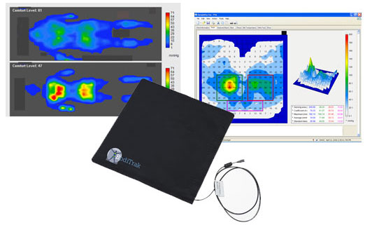
What is Pressure Mapping?
A non-invasive, objective computer based sensing device that actively records pressure distribution and pressure shifts providing a color based image of the patient’s pressure distribution in a given position
It is a clinical tool that supplements overall assessment and does not replace clinical judgment

Slide 4
Goals of pressure mapping
Identify problem areas and peak pressure areas (most commonly around bony prominences) while sitting in a wheelchair*
Establish an appropriate wheelchair set up and patient positioning that will optimize pressure distribution
Determine effectiveness of pressure relief
Provide education and visual feedback to improve patient/caregiver compliance
Aide in creating a plan of care to minimize risk the of skin breakdown and promote healing of current wounds
Get the patient out of bed early in their stay and allow for safe prolonged sitting time
Notes:
*If there are concerns with pressure on the patient’s back, the wheelchair sensor pad can be placed between the patient and their back support to analyze pressure distribution. Bed sensor pads are available to allow pressure mapping to be completed in a patient’s hospital bed. At SCC we only have the wheelchair sensor pad.

Slide 5
Who should be pressure mapped?

Slide 6
Pressure mapping decision tree

Slide 7
*If pressure mapping is indicated, inform your supervisor, therapy scheduler, and trained therapist to schedule a pressure mapping session as soon as possible.

Slide 8
When preparing for a pressure mapping session have the following information available:
What is the patient’s functional/cognitive status?
Can the patient weight shift/reposition independently? What is their out of bed/upright tolerance? Does the patient have cognitive deficits impacting comprehension/carryover of information?
Are there any sitting/postural concerns?
Is there any skin breakdown? If yes, where?
What is the patient’s current wheelchair set up?
What wheelchair set up/cushion(s) do you want to trial?

Slide 9
What to expect during the session:
A sensor pad is positioned between the patient and the wheelchair cushion
Real time data is displayed on the computer software
Pressure distribution is assessed in a static position as well as during functional movements (UE movement and WC propulsion)
Sitting surface/wheelchair set up is adjusted as needed to optimize pressure redistribution
Effectiveness of pressure reliefs is assessed (lateral weight shift, anterior weight shift, push up)
Education is provided to the patient reinforcing the importance of pressure reliefs every 15 minutes

Slide 10
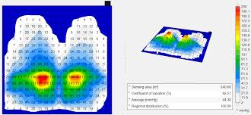
Interpretation of results
Areas of high (red) and low (blue) pressure measured in mmHg
Peak pressures < 80mmHg (blue) = no intervention necessary.
Peak pressures 80–120mmHg (green) = readjust or try other cushions, educate client on pressure relief.
Peak pressures 120-200mmHg (yellow, orange, and red) = potentially serious clinical issues, investigate/try other cushions, need advanced pressure relief techniques (tilt, etc).
Surface area: How much surface contact is being made between the patient and the sitting surface
Higher sensing area = greater surface contact with the sensor mat
Coefficient of variation (%): How evenly the pressure is re-distributed across the supporting system
Lower percentage = more even pressure redistribution
Inverse of sensing area
Notes:
Example of the computer based image.

Slide 11
After a pressure mapping session
The trained pressure mapping therapist will complete the Pressure Mapping Evaluation progress note in Epic with attached data images captured during the session.
Additional pressure mapping sessions are scheduled if necessary to either complete the initial pressure mapping or on an as needed basis determined by the primary therapist.

Slide 12
Roho Wheelchair Cushion Review
Recommended for skin breakdown or correcting/accommodating stability needs that the patient may have
No weight limit
3 cell heights
High profile: 4” cell height
Mid profile: 3” cell height
Low profile: 2” cell height
The higher the cell the greater immersion depth allowed
Immersion allows for greater contact area and pressure distribution
At SCC we have 3 different types of Roho seat cushions
Dry Inflation cushion (standard Roho) in low profile and high profile cell heights
Quatro Select cushion
Enhancer cushion
Place a solid insert under the Roho cushion if the wheelchair has a sling seat
Ensure the cushion is placed properly in the correct size cover. The pump valve should exit the cushion anteriorly at the patient’s left leg. Zipper of the cushion should be in the back.

Slide 13
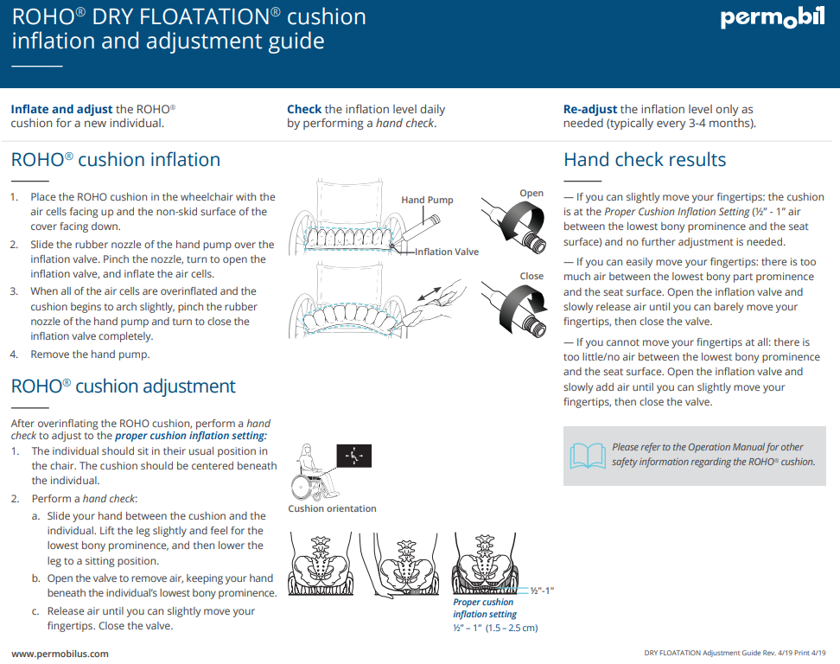

Slide 14
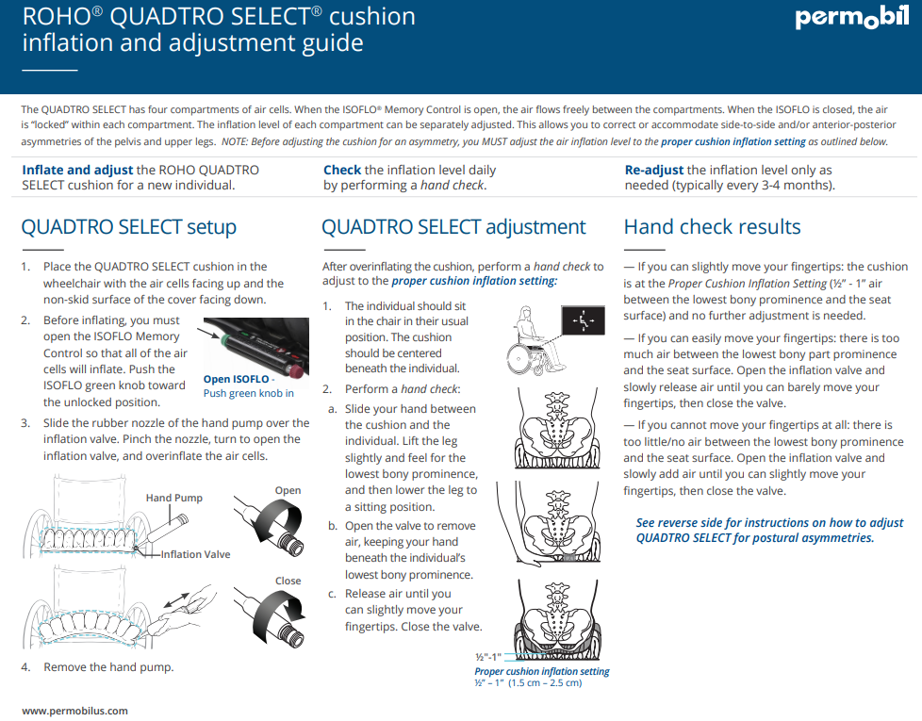

Slide 16
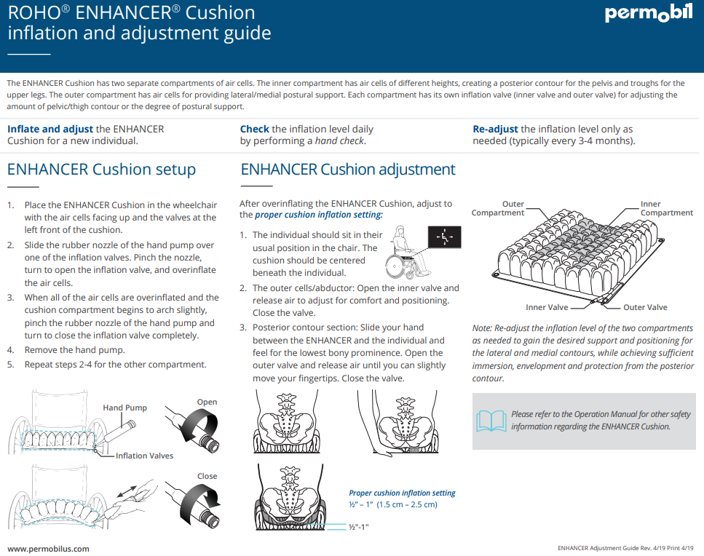

Slide 17
Case Examples

Slide 18
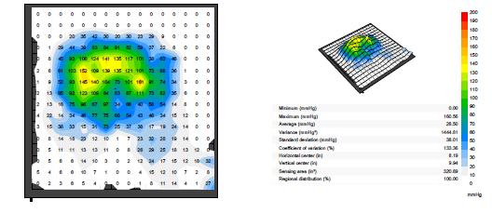
Patient B
73 y/o male T2 paraplegia 7 months prior to admission to SCC
Presented to SCC with a stage 3 pressure injury on the left ischial tuberosity
WC set up: power WC with tilt function, Jay Fusion cushion (air filled pockets posteriorly, foam anteriorly), Matrx Elite solid back, and headrest.
Pressure mapping completed in the patient’s self selected “ comfortable position” which was the wheelchair in a slightly tilted position
Initial image with the patient in his self selected “comfortable position” on a fully inflated cushion.
What was noted:
Increased pressure (yellow and green) with poor pressure distribution
Action taken:
Air was removed from the cushion to aide in the redistribution of the pressure
Notes:
Always start with a fully inflated Roho cushion and remove air as needed throughout the pressure mapping session (it is easier to remove air than it is to add it)

Slide 19
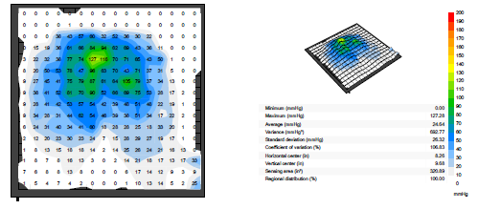
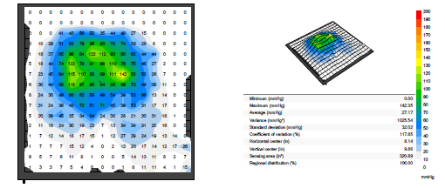
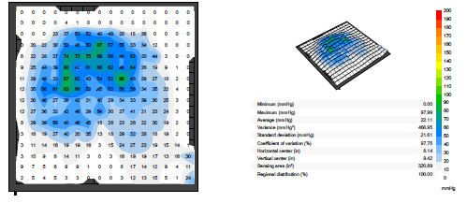
Patient B - Pressure Redistribution
Image #1- cushion fully inflated
Image #3 - Additional 3 seconds of air removed
Image #2 - 5 seconds of air removed
Image #4 (final) - Cushion slightly reinflated

Slide 20
Patient B
By removing air from the cushion:
Lowered the Coefficient of variation
Increased immersion → great contact area with the cushion → increased pressure distribution
Improved thigh support decreases the amount of pressure going through the buttocks
Decreased the maximum pressure points

Slide 21
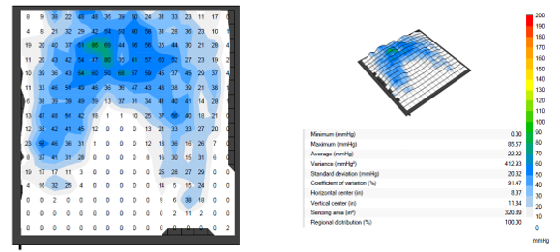
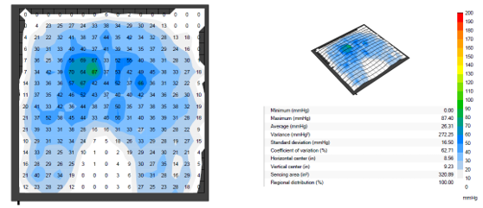
Patient C
27 y/o male presenting to SCC with a T2-3 spinal cord infarct
Stage IV sacral ulcer being treated with a wound VAC
Patient was fitted for a custom WC at a prior facility and provided a loaner WC until custom chair was ready
Pressure mapping was completed on both SCC provided WC and his own loaner WC
Spaulding 18” standard sling back manual WC, with 18” Roho seat cushion and solid seat insert, B elevating leg rest, grip socks donned
Quickie rigid frame WC, 4” high profile Roho cushion, Roho Agility solid back, grip socks donned

Slide 22
Patient C - Wheelchair comparison
Lower coefficient of variation* in patient’s loaner WC (62.71%) compared to SCC provided WC (91.47%)
Similar maximum pressure in the patient’s loaner WC (85.57mmHg) and the SCC provided WC (87.40 mmHg)
Conclusion:
Both WC systems would be appropriate for the patient with pressure reliefs completed every 15 minutes**
To improve pressure redistribution and lower the coefficient of variation in the SCC provided WC, Patient C would benefit from:
Hanging swing away leg rests as opposed to the elevating leg rest in order to increase thigh support
Additional back /lumbar support to minimize posterior pelvic tilt resulting in decrease pressure through buttocks
Notes:
*Coefficient of Variation (%): how evenly the pressure is re-distributed across the supporting system
o Lower percentage = more even pressure redistribution
** We do not always need specialized equipment to achieve an adequate seating system.

Slide 23
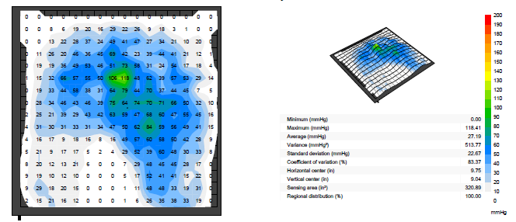
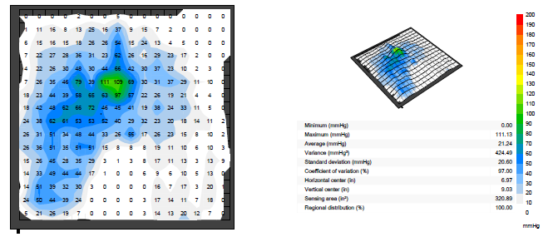
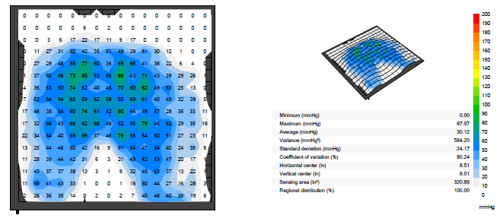
Patient C - Pressure reliefs
R lateral weight shift
L lateral weight shift
Anterior weight shift
Notes:
The patient demonstrates effective pressure reliefs utilizing lateral weight shift technique.
Recommended pressure reliefs every 15 minutes while in the WC. Patient C was on a turning scheduled in bed as well.

Slide 24
Common barriers to patient completing pressure reliefs:
Patient does not have the strength/endurance to complete sufficient pressure relief
Cognitive deficits limiting carryover
Limited “buy in” regarding the importance of completing pressure reliefs
Ways we can help:
Timers set to every 15 minutes/ reminders set on smart devices
Provide visual feedback/education for reinforcement
Make it a team goal

Slide 25
Resources/references
ROHO cushion set up and adjustment
https://www.youtube.com/watch?v=WNQQLQ7l0Wc
https://cdn2.hubspot.net/hubfs/1624307/Education%20Resources/ROHO%20DRY%20FLOATATION%20Cushion%20Adjustment%20Quickguide_11x8.5%20(0419).pdf
https://cdn2.hubspot.net/hubfs/1624307/Education%20Resources/ROHO%20ENHANCER%20Cushion%20Adjustment%20Quickguide_11x8.5%20(0419).pdf
ROHO QUADTRO SELECT set up and Adjustment
https://www.youtube.com/watch?v=Ea7jGaspB4Y
https://cdn2.hubspot.net/hubfs/1624307/Education%20Resources/ROHO%20QUADTRO%20SELECT%20Cushion%20Adjustment%20Quickguide_11x8.5%20(0419).pdf
ROHO ISOFLO Memory Control
https://www.youtube.com/watch?v=pF-U3IDLgJk
ROHO inflation Hand Check
https://www.youtube.com/watch?v=6TxGKyEzUao
BodiTrak Pressure Mapping Users Manual

